Slide 1
DPDK Userspace 2018
Dublin, September 5th & 6th, 2018
#DPDKUserspace

Slide 2
DPDK Community Appreciation & Awards
Dublin, September 5th, 2018

Slide 3
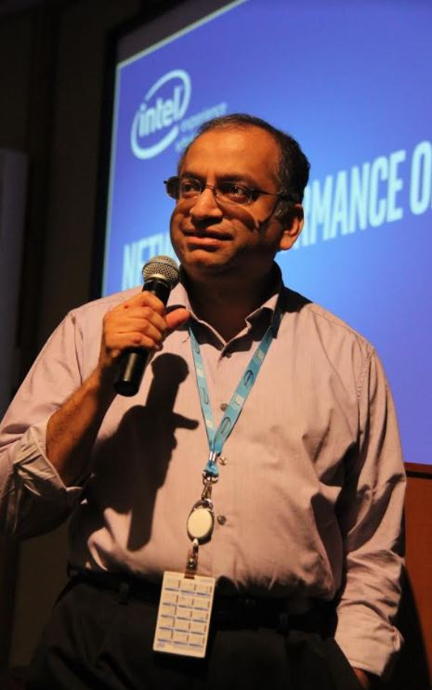
DPDK ”Venky” Student Travel Scholarship

Slide 4
2018 CONTRIBUTION AWARD

Slide 5
2018 CONTRIBUTION AWARD
- Code -
Anatoly Burakov

Slide 6
2018 CONTRIBUTION AWARD

Slide 7
2018 CONTRIBUTION AWARD
- Reviewing -
Ferruh Yigit

Slide 8
2018 CONTRIBUTION AWARD

Slide 9
2018 CONTRIBUTION AWARD
- MaintAiner –
Thomas
Monjalon

Slide 10
2018 CONTRIBUTION AWARD

Slide 11
2018 CONTRIBUTION AWARD
- Documentation -John
McNamara

Slide 12
2018 CONTRIBUTION AWARD

Slide 13
2018 CONTRIBUTION AWARD
- Testing -
Intel Validation Team

Slide 14
DPDK Community Appreciation & Awards
Dublin, September 5th, 2018

Slide 15
2018 DPDK TOP AMBASSADOR

Slide 16
2018 DPDK TOP AMBASSADOR
Jim
St. Leger

Slide 17
2018 INNOVATION AWARD

Slide 18
2018 INNOVATION AWARD
Compression API

Slide 19
2018 INNOVATION AWARD

Slide 20
2018 INNOVATION AWARD
Berkeley Packet Filter Library (BPF)

Slide 21
2018 INNOVATION AWARD

Slide 22
2018 INNOVATION AWARD
Virtio 1.1

Slide 23
DPDK Community Appreciation & Awards
Dublin, September 5th, 2018

Slide 24
2018 DPDK PROJECT SERVICE AWARD

Slide 25
2018 DPDK PROJECT SERVICE AWARD
Thomas
Monjalon

Slide 26
DPDK Community Appreciation & Awards
Dublin, September 5th, 2018

Slide 27
DPDK Community Appreciation & Awards
Dublin, September 5th, 2018

Slide 28
DPDK Community Appreciation & Awards
Dublin, September 5th, 2018

