Slide 1
Multiple vDPI Functions using DPDK and Hyperscan on OVS-DPDK Platform
Cheng-Chien SU
Fang-Chen KUO
LIONIC Corp.

Slide 2
What is Deep Packets Inspection?
Application Identification
Content Inspection
Packets flow
pass through the network
Device Identification
. . .
. . .
. . .
Malicious Websites
Viruses
Hack’s
Intrusion
Router / Setup-Box Gateway

Slide 3
Deep Packet Inspection Problem
Deep Packet Inspection
(Snort2.9.11)
Packet
1 Gbps (Line rate)
reduced 96% throughput
0.038 Gbps
Note: Intel Atom C3958 Platform

Slide 4
Agenda
DPI Workflow
How to improvement DPI throughput in Intel Platform
DPDK
Hyperscan
Content Merging
Multiple vDPI Function on OVS-DPDK Platform
Throughput Comparison

Slide 5
DPI Workflow (1/2)
Flow
Management
Pre-Filter
Post-Checker
Flow
Action
Multiple Pattern Matching for Payload
Packet In
Packet Out
Network Interface Controller

Slide 6
DPI Workflow (2/2)
Flow
Management
Pre-Filter
Post-Checker
Flow
Action
L3&L4 header matching
More exactly pattern matching
Packet In
Packet Out
Network Interface Controller

Slide 7
DPI - Example
Flow
Management
Pre-Filter
Post-Checker
Flow
Action
alert tcp any any -> 192.168.0.0/16 any (msg:”VIRUS”; content:”virus”; dsize:300<>400; sid:10000;)
alert tcp any any -> 192.168.1.0/24 any (msg:”SKYPE”; content:”skype”; pcre:”/^skype=[0-9a-z]{10}/”; sid:20000;)
alert UDP 192.168.0.0/16 any -> any 53 (msg:”DNS Query”; content:”google”; pcre:”/\x01\x00.*google0x03.com/”; sid:30000;)
Packet In
Packet Out
Network Interface Controller

Slide 8
How to improvement DPI throughput in Intel Platform
Flow
Management
Pre-Filter
Pre-Filter
via Hyperscan
Post-Checker
Flow
Action
Packet In
Packet In
via DPDK
Packet Out
Packet Out
via DPDK
Network Interface Controller

Slide 9
Content Merging (1/2)
Pre-filter support regular expression
Increase the complexity of pattern to reduce the number of post check
Compatible with snort format

Slide 10
Content Merging (2/2)
alert tcp $EXTERNAL_NET any -> $HOME_NET any (content:"|12 01|"; content:"|01 00 00 00|"; within:5; distance:2;)
Pattern: “\x01\x00\x00\x00”
Regular Expression: “\x12\x01.{2,3}\x01\x00\x00\x00”

Slide 11
Lionic DPI SDK (1/2)
Lionic DPI-SDK provide antivirus, intrusion prevention system, application identification, device identification and web content filtering.
Lionic DPI-SDK is compatible with snort rule format.
Lionic DPI-SDK supports DPDK and Hyperscan.

Slide 12
Lionic DPI SDK (2/2)
Virus
Signature
IPS
Signature
Device Signature
Application Signature
Web Content
Cloud Database
Signature Database
Anti-Virus
Intrusion Prevention System
Device Identification
Application Identification
Web Content Filtering
Applications Services
Hardware DPI – LA3000
Pattern Matching Processor (Silicon IP)
Software DPI
Pattern Matching Library
DPI Engine
Lionic DPI SDK

Slide 13
Multiple vDPI Function on OVS-DPDK Platform
VM
VM
VM
VM
IPS
with Hyperscan
App Ident
with Hyperscan
Antivirus
with Hyperscan
vDPI Function
with Hyperscan
DPDK
DPDK
DPDK
DPDK
VirtIO
VirtIO
VirtIO
VirtIO
OvS-DPDK
DPDK vHost Acceleration
ovs-vswitchd
ofproto
NIC

Slide 14
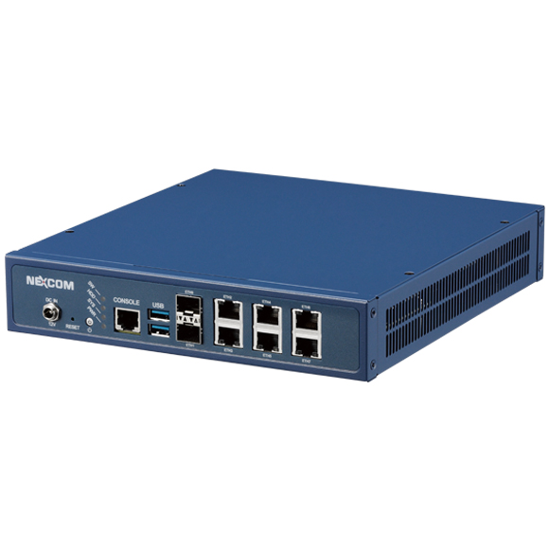
Test Platform Specification
Hardware – NEXCOM vDNA 1160
Intel Atom C3958 SoC 16 cores @ 2GHz
Memory: 32GB
NIC: Intel i350 AM4 1GbE*4, Marvell PHY 1GbE*2
OS: Debian 9.4
OvS version: 2.9.0
DPDK version: 18.02.1
Hyperscan version: 4.7.0
Snort Version: 2.9.11
All the VMs are created by KVM and emulated by QEMU
Run IXIA IxLoad (version 3.30.58.17) on the provided environment

Slide 15
Test Environment
Guest VM
vDPI Function
with Hyperscan
DPDK
VirtIO
HTTP Traffic
OvS-DPDK
NIC
NIC

Slide 16
Throughput Comparison
vDPI Function | Throughput (Mbps) | Impact
No inter-VM | 872.29 | 0%
Snort (NFQ, Aho-Corasick) | 38.71 | 96%
Snort (NFQ, Hyperscan) | 95.84 | 89%
Snort (DPDK, Hyperscan) | 269.39 | 69%
Lionic-IPS (DPDK, Hyperscan) | 795.02 | 9%
Lionic-App_Ident (DPDK, Hyperscan) | 864.77 | 1%
Note: IPS rules are 9791, App_Ident rules are1858

Slide 17
Snort Resource
Snort access packets via DAQ module
Patch for DAQ-2.0.6 available at:
http://seclists.org/snort/2016/q2/385
Follows the instruction on the page to build Snort with patched DAQ module
Snort 2.9.x does not support using Hyperscan as MPSE
Patch for Snort 2.9.8.2 are available at:
https://01.org/zh/downloads/hyperscan-integration-snort-2.9.8.2-and-2.9.9.0?langredirect=1
Some modification based on the patch to support Snort 2.9.11.1

Slide 18
THANK YOU!
arthur.su@lionic.com
kuo.kuo@lionic.com

