Slide 1
Welcome and Intro
DPDK Summit India - Bangalore - 2018

Slide 2
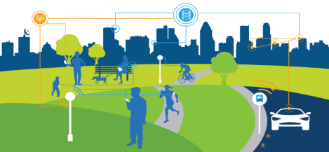
5G + IOT requires NETWORK transformation
2 ZB Global
Data Traffic
Annually by 2019¹
5G
50 B ² Connected Devices
1000X Capacity
50X Peak Data Rate
10X Latency Reduction
Device Centric Network
Sources: 1. Cisco Virtual Networking Index, 2015. 2. IDC, IoT Market Forecast: Worldwide IoT Predictions, 2015.
Notes:
1.3EB per month @2017 and expected to grow to 14EB @2023. 3.9GB per smartphone to 18GB @2023
https://economictimes.indiatimes.com/tech/internet/data-usage-per-smartphone-in-india-to-grow-5-fold-by-2023-ericsson/articleshow/61838209.cms

Slide 3
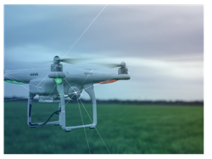
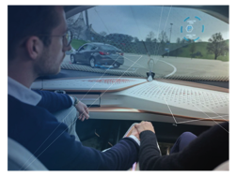
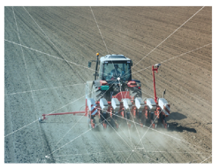
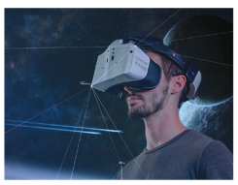
Drones
5G enhancements will transform lives
Ultra Reliability
and Low Latency
Drones
Healthcare
Emergency Services
Autonomous Driving
Massive M2M
Connectivity
Supply Chain/
Logistics
Smart Cities
Smart Agriculture
Manufacturing
Enhanced Mobile
Broadband
Virtual and
Merged Reality
Mobile Office
Broadband to Home
Entertainment

Slide 4
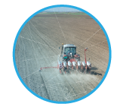
Matching cloud services to diverse delivery needs
Intel technology delivers the diverse processing requirements to power 5G network slicing
5G Network Slices
High Bandwidth
Wireless Broadband
Ultra Low Latency
Real Time Control
Low Energy/ Low Bandwidth
IoT / Sensors
Ultra High Bandwidth
Video Streaming
Cloud

Slide 5
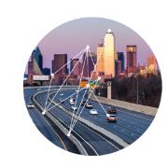
5G Networks of the Future
Today’s public network
Tomorrow
COTS necessary, enables broader ecosystem, new business opportunities, workload convergence, i.e Network in a box for enterprises
Smart City/Communities
Network in a box with regional data centers
Indoor and outdoor connectivity, presence, city/transportation infrastructure apps
Multi-spectrum: alternative, licensed & unlicensed
Data Center
v MEC + vEPC
RRH
eNode B
Backhaul
RRH
Evolved Packet Core
Subscriber Mgmt/Charging
Factories/manufacturers
Network in a box providing application slice(s)
Application and multi-spectrum (alternative, licensed, unlicensed) for indoor/outdoor connectivity
Network in a box:
Mobile Edge Computing , vEPC
Notes:
For instance, this is an example of what the future network could look like
Smart cities with various connectivity for coverage and specific applications for public safety, health, transportation, and infrastructure could be a slice or multiple slices out of the network
Factories and Manufacturers have different application and coverage needs, but the basic foundation is similar

Slide 6
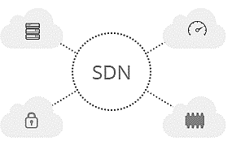
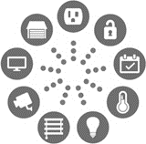
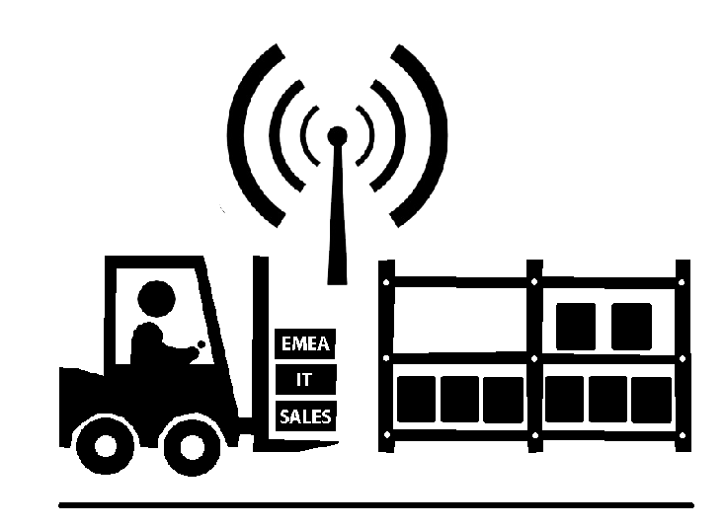
5G + IOT E2E Communication Transformation
Device/ Machine/On-Site edge/Fog
Access
Network/Far edge
Core
Network
Internet / Cloud
access technology
Small cells
Network function virtualization
5G
4G
IOT
C-RAN (Remote Radio Heads)
Edge
Compute
Edge Compute
NB-IOT, CATM, LORA, SigFox
3G/2G
Operating System
WiFi/WiGig
Hypervisor
Security
Wired
CCG/DCG
Smart Device / Machines as Integral
Part of E2E Comms Network
Sliceable Virtualized Network
Notes:
Here is a diagram of the future network. Provides an ample play for dpdk to meet the various requirements like higher throughput, lower latency, burst traffic handling, QoS etc.

Slide 7
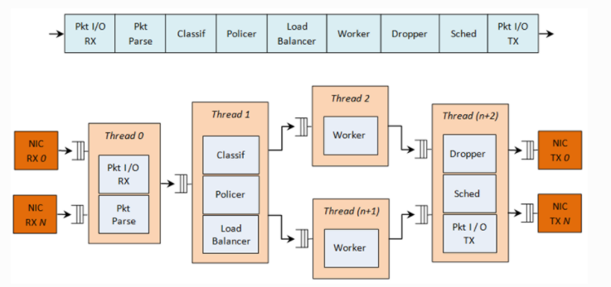
Complex Packet Processing Pipeline with QoS Support

Slide 8
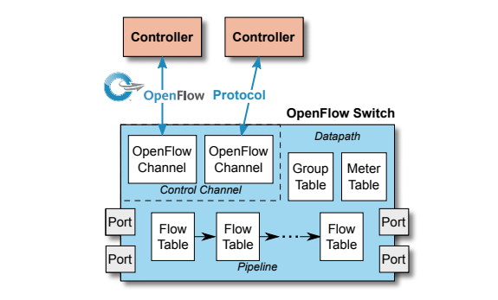
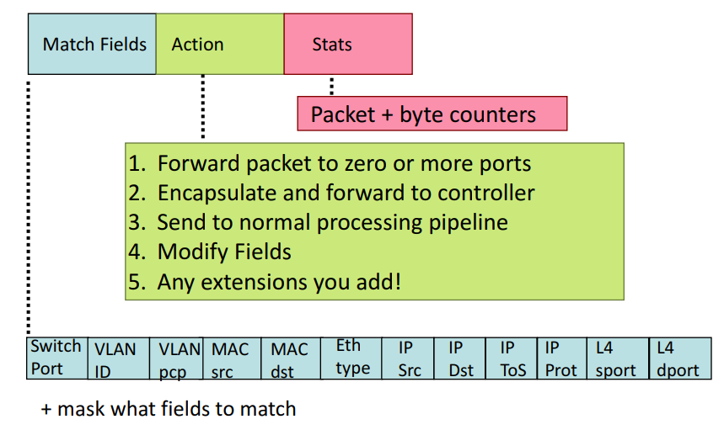
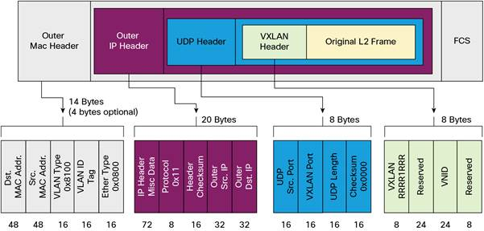
Packet Look ups in an OpenFlow* switch.
Port | Src MAC | Dest Mac | VLAN ID | Priority | Ethertype | Src IP | Dest IP | IP TOS | Action
* | * | * | * | * | * | 192.168.*.* | 192.169.*.* | 32 | Q1
* | * | 0A.C8.* | 10 | * | * | * | * | * | Port1
* | * | * | * | * | * | 172.19.*.* | 172.19.*.* | 72 | Q2
* | * | * | * | * | * | 172.19.*.* | 172.19.*.* | 96 | Q3
* Third party Trademark, Other names and brands may be claimed as the property of others.

Slide 9
Questions?

Slide 10
5G + IOT requires NETWORK transformation
2 ZB Global
VIRTUALIZED
Data Traffic
SOFTWARE DEFINED
CLOUD ENABLED
Annually by 2019¹
Transforming
Architecture
Value Chain
Business Process
Workforce
NETWORK
50B Connected
Agility + SCALE
Devices by 2020²
with IA
Sources: 1. Cisco Virtual Networking Index, 2015. 2. IDC, IoT Market Forecast: Worldwide IoT Predictions, 2015.
Notes:
he massive influx of devices and use cases coming with 5G and IOT will drive tremendous pressure on next generation infrastructure. How do you cope with the volume and complexity of that data on the infrastructure? How do you enable the next gen services that have yet to be invented (the next Uber, next Airbnb, etc.)? The network must scale to support billions of devices, and a wide variety of use cases.
The amount of annual global data traffic has been doubling since 2011. And by 2019, Cisco says that 2 zettabytes of traffic will traverse global networks annually. In case you don’t know what a zettabyte is, it’s 10²¹. Just to give you some sense for how BIG that number is, one zettabyte is equivalent to 20 billion dual-layer Blu Ray discs.
All of these factors leading to need to transform the network to cope with increasing capacity demands and accelerate delivery of new services and capabilities.
What’s the technology shift behind this transformation? Today, the network is composed of purpose-built infrastructure with each device containing its own management software. You have separate pieces of equipment for functions like routing, virtual private networking, and firewall. This makes it very difficult for operators to deploy new services as each device is individually provisioned.
The network of tomorrow will be deployed using Network Functions Virtualization and Software Defined Networking, or NFV & SDN. Instead of running a separate router, VPN, and firewall on three different pieces of hardware, you can run all three on the same Intel architecture based infrastructure. This has obvious CAPEX benefits – consolidate 3 hardware purchases into one. Add to that Software Defined Networking. Now you’re adding intelligence to network. In SSN, the software -- let’s say firewall software – tells the networks the resources it needs through orchestration software. These resources are then automatically configured on the hardware – all the way through the network. SDN can greatly reduce OPEX by making it easier to provision services throughout the network. Additionally, you can swap out hardware without reconfiguring your orchestration software. This is providing tremendous value to service providers to terms of driving network scale and agility while reducing CAPEX and OPEX expenditures.
But while this transformation includes architectural & technology transformation, it is also equally importantly about transforming the way network operators do business to make this architectural shift a reality. It means bringing new players into the value chain, redefining business processes, and retooling workforce skillsets away from purpose-built hardware to software-defined technologies.
The result is cloud-ready networks. Networks that are scalable enough to cope with next-generation demands on the number of devices, amount of traffic, level of performance, and complexity and variety of use cases. Networks that are agile enough to develop and deploy new services with “push-button” ease; highly automated, secured, and managed. And these scalable, agile networks enable agile businesses – driving a quicker pace of business model innovation and revenue generation.

Slide 11
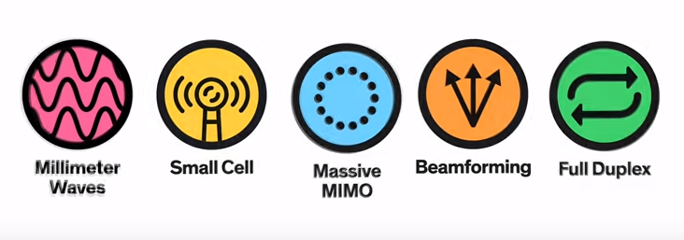
5 Pillars of 5G RAN
Millimeter Waves - 3kHZ -6GHz to 30-300 GHz
Small Cells-Thousands of low powered mini base stations
Massive MIMO-Advanced multi-input, multi-output antenna technology
Beam Forming-Transmit data through targeted beams
Full Duplex- Ability to send both uplink and downlink signal on the same frequency band

