Slide 1
Accelerate Vhost with vDPA
Xiao Wang

Slide 2
Agenda
Vhost evolution
An Ideal framework for vhost ACC
vDPA design and impl
DPDK vhost lib and vDPA driver
QEMU vhost user extention for vDPA
Upstreaming Status
Acc vhost with vDPA
Key Takeaway

Slide 3
vhost evolution
Vhost evolution
Para-V Flexibility ☺
CPU usage and perf bottleneck ☹
An ideal framework would achieve:
Pass-thru like perf
Virtio spec compliant
Cloud friendly
Multi-vendor
Minimum CPU usage
VM
VM
VM
Virtio drv
Virtio drv
Virtio drv
Virtio dev
Virtio dev
Virtio dev
QEMU virtio backend
Kernel vhost
DPDK vhost
Tap
Tap
HW accelerator
VM
VM0
VM1
Pass-thru for virtio
CPU usage and perf ☺
virtio 0.95&1.0 ☹
LM with Pass-thru ☹
Multi-vendor ☹
Stock VM ☹
Virtio 0.95
VM0
VM1
Virtio drv
Virtio 1.0
Virtio drv
Virtio drv
GOAL
SW vhost
Live Migration
NIC w/ Switch
NIC w/ Switch

Slide 4
vDPA: enable datapath pass-thru within Para-V
vDPA--Vhost Datapath Acceleration
Build pass-thru like datapath within Para-V
Inherit all PV advantages
Decomposed VRING Data Path on ACC
DMA Enq/Deq VRING via IOMMU
Interrupt Notification
VFIO INTR eventfd associate with IRQFD
IRQFD as token for irq_bypass Prod/Cons
Leverage existing posted-interrupt support
Doorbell Kick
SW Relay IOEVENTFD to trigger doorbell (virtio 0.95, PIO)
Add guest physical memory slot for doorbell direct mapping (virito 1.0, MMIO)
ACC = Accelerator(VRING Capable)

Slide 5
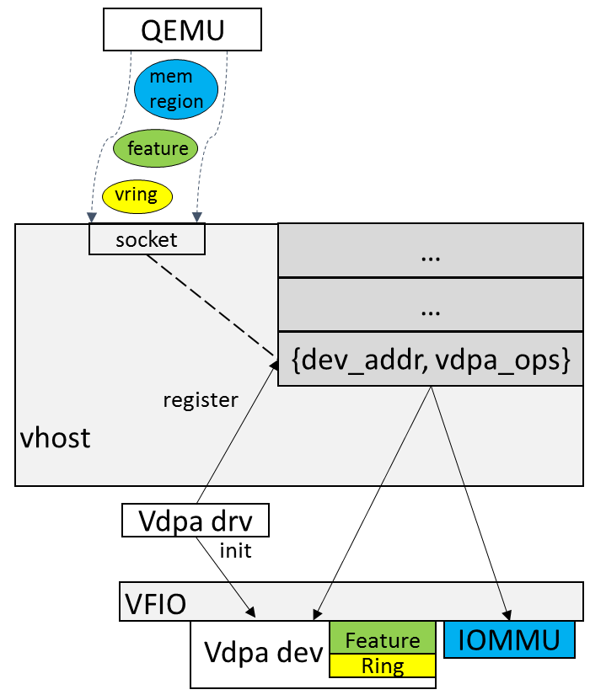
vDPA Design & Impl
Leverage vhost user
Unified interface for SW/HW
Base on existing vhost protocol
DPDK vhost lib
Socket management
API for vdpa register/unregister
API for device attach/detach to socket
Vdpa_ops: vhost message driven callback

Slide 6
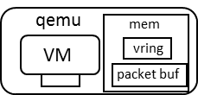
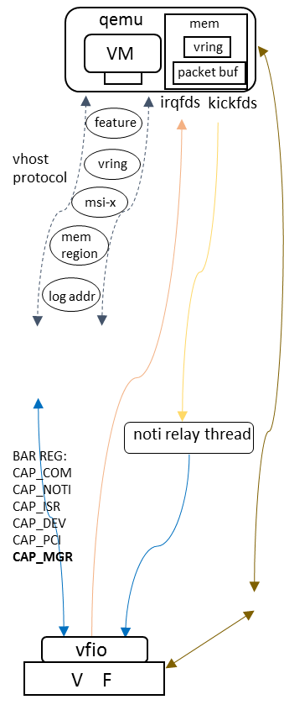
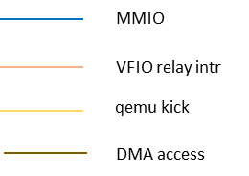






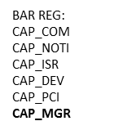

Step 1: vDPA with relay
Relay based on ioeventfd
VMEXIT
CPU Usage
Long Latency
INTR & NOTIFY pass-thru?
irqfds
kickfds
vhost
protocol
vhost protocol
vhost server
vdpa ops

Slide 7






Step2: Partial Pass-thru for direct kick
VM
Virtio Dev
Extend Vhost protocol:
VHOST_USER_PROTOCOL_F_HOST_NOTIFIER
Queue Based Notifier
Partial Pass-thru: Notify Reg => HW doorbell
No VMEXIT ☺
Notify Reg
Notify Reg
QEMU
Slave Handler
Master Channel
Slave Channel
Extended Page Table
vhost user
vDPA driver
vDPA device
Doorbell
Doorbell

Slide 8
Upstreaming Status
18’Q2 QEMU vhost user support for vDPA [Merged]
DPDK 18.05 vDPA framework in vhost [Merged]
DPDK 18.05 IFCVF vDPA driver [Merged]
2018 Q3/Q4 support vIOMMU and Posted Interrupt [WIP]
Kernel vDPA (https://lwn.net/Articles/750770/) [RFC]
Para-virtualized device w/ HW acceleration is going forward.
Welcome on board!

Slide 9
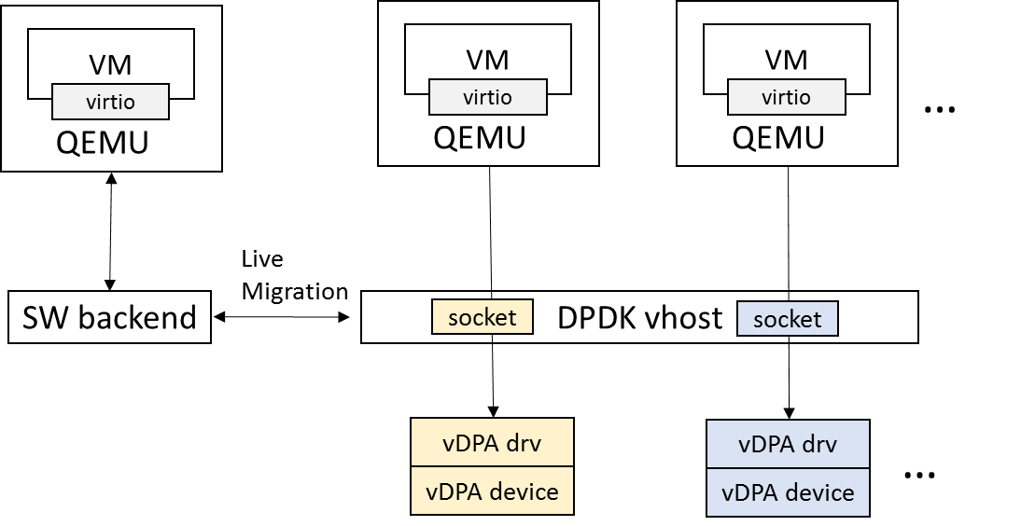
Acc vhost with vDPA
HW focus only on datapath
Differentiated vDPA devices
On-demand resource allocation
Offload features
MQ
Upgrade Stock VM to vDPA via LM
No feature gap
Cross-backend LM
Vice Versa

Slide 10
Key Takeaway
vDPA allows vHost HW acceleration in a cloud friendly way
vDPA framework upstreaming going forward
Leverage vDPA framework to:
Accelerate virtio with minimum HW requirement
Upgrade stock VM via live migration to platform with HW accelerator
Welcome for any feedback/contribution

Slide 11
Thanks!

