Slide 1
Hardware-Level Performance Analysis of Platform I/O
Patrick Lu, Roman Sudarikov
intel

Slide 2
Legal Disclaimer & Optimization Notice
Software and workloads used in performance tests may have been optimized for performance only on Intel microprocessors. Performance tests, such as SYSmark and MobileMark, are measured using specific computer systems, components, software, operations and functions. Any change to any of those factors may cause the results to vary. You should consult other information and performance tests to assist you in fully evaluating your contemplated purchases, including the performance of that product when combined with other products. For more complete information visit www.intel.com/benchmarks.
INFORMATION IN THIS DOCUMENT IS PROVIDED “AS IS”. NO LICENSE, EXPRESS OR IMPLIED, BY ESTOPPEL OR OTHERWISE, TO ANY INTELLECTUAL PROPERTY RIGHTS IS GRANTED BY THIS DOCUMENT. INTEL ASSUMES NO LIABILITY WHATSOEVER AND INTEL DISCLAIMS ANY EXPRESS OR IMPLIED WARRANTY, RELATING TO THIS INFORMATION INCLUDING LIABILITY OR WARRANTIES RELATING TO FITNESS FOR A PARTICULAR PURPOSE, MERCHANTABILITY, OR INFRINGEMENT OF ANY PATENT, COPYRIGHT OR OTHER INTELLECTUAL PROPERTY RIGHT.
Copyright © 2018, Intel Corporation. All rights reserved. Intel, Pentium, Xeon, Xeon Phi, Core, VTune, Cilk, and the Intel logo are trademarks of Intel Corporation in the U.S. and other countries.
Optimization Notice
Intel’s compilers may or may not optimize to the same degree for non-Intel microprocessors for optimizations that are not unique to Intel microprocessors. These optimizations include SSE2, SSE3, and SSSE3 instruction sets and other optimizations. Intel does not guarantee the availability, functionality, or effectiveness of any optimization on microprocessors not manufactured by Intel. Microprocessor-dependent optimizations in this product are intended for use with Intel microprocessors. Certain optimizations not specific to Intel microarchitecture are reserved for Intel microprocessors. Please refer to the applicable product User and Reference Guides for more information regarding the specific instruction sets covered by this notice. Notice revision #20110804

Slide 3
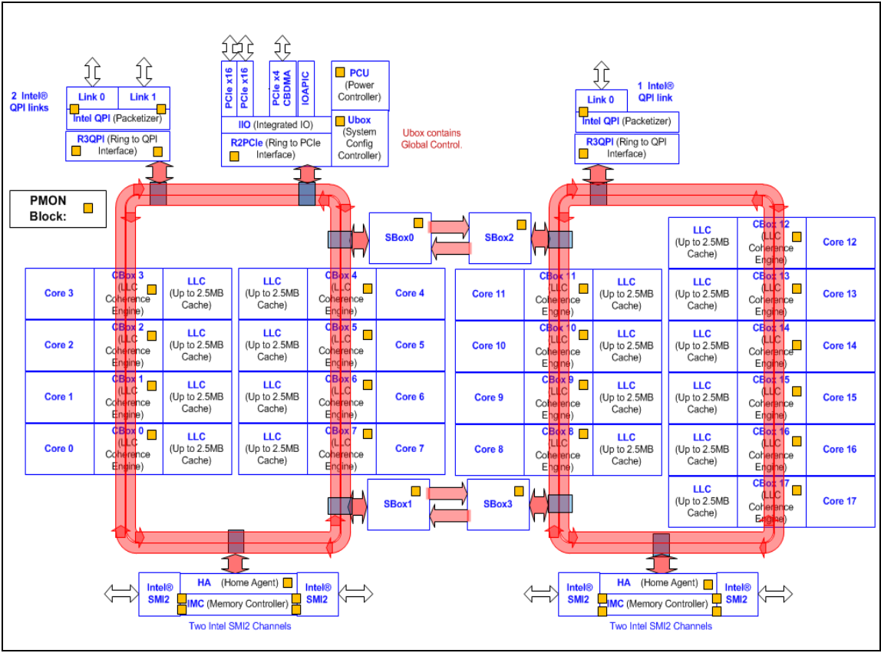
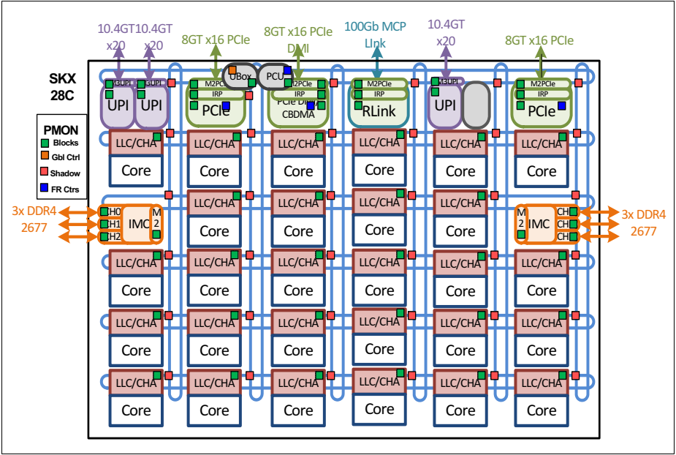
New Modular PCIe Controller Interconnect
Intel® Xeon® Processor E7 v3 Family – 18C Block Diagram
Intel® Xeon® Processor Scalable Family – 28C Block diagram
Prior to Intel® Xeon® Scalable Processor, all PCIe lanes aggregated to single ring stop. In Intel® Xeon® Scalable Processor, 3x16 PCIe lanes split to three mesh stop. (higher concurrent I/O)

Slide 4
Re-Architected L2 & L3 Cache Hierarchy
Shared-distributed ➔ shared-distributed L3 is primary cache
Private-local ➔ private L2 becomes primary cache with shared L3 used as overflow cache
Previous Architectures
Skylake-SP Architecture
Shared L3
2.5MB/core
(inclusive)
Shared L3
1.375MB/core
(non-inclusive)
L2 (1MB private)
L2 (1MB private)
L2 (1MB private)
L2 (256KB private)
L2 (256KB private)
L2 (256KB private)
Core
Core
Core
Core
Core
Core
Shared L3 changed from inclusive to non-inclusive:
Inclusive (prior architectures) ➔ L3 has copies of all lines in L2
Non-inclusive (Skylake architecture) ➔ lines in L2 may not exist in L3
On-chip cache balance shifted from shared-distributed
(prior architectures) to private-local (Skylake architecture)

Slide 5
Inclusive vs Non-Inclusive L3
Memory reads fill directly to the L2, no longer to both the L2 and L3
When a L2 line needs to be removed, both modified and unmodified lines are written back to DRAM
Data shared across cores are copied into the L3 for servicing future L2 misses
Inclusive L3
(prior architectures)
Non-Inclusive L3
(Skylake-SP architecture)
L2 256kB
3
L2 1MB
3
2
2
2.5 MB
L3
1.375 MB
L3
1
Memory
1
Memory
Though software should be agnostic to the change,
it may see different traffic pattern versus prior server implementations

Slide 6
Cache Usage on I/O and Core Interactions
I/O reads to memory are non-allocating, i.e., if line is not present in LLC it is not allocated; if line is in LLC, it stays there, if it is in one of L2s, it moves or gets copied to LLC
I/O writes to memory can be allocating or non-allocating based on no-snoop attribute
Allocating writes: Writes invalidate core caches and allocate the line in LLC cache where I/O is done
Non-allocating writes: Writes invalidate core caches and update memory
CPU supports DDIO where a subset of ways (default is 2) in LLC cache is used to allocate data brought in by I/O agents
DDIO ways can be written by cores, whereas I/O can’t write into core ways
Any performance enhancement technology
built around last level cache may need to be revisited

Slide 7
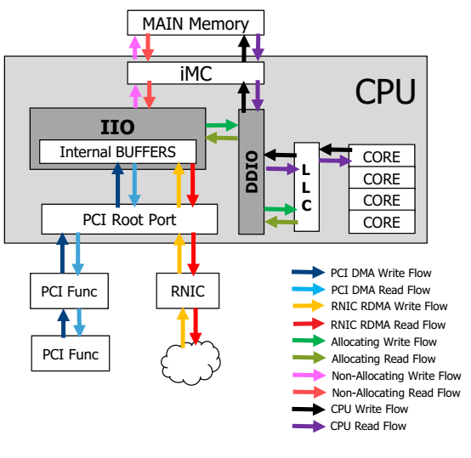
IIO transaction flow – Overview
IIO – Integrated I/O Controller
Controls I/O flow between PCIe devices and Main Memory
“Allocating write transactions”
PCI Root Port will utilize write buffers backed by LLC core cache when the target write buffer has WB attribute
Data buffers naturally aged out of cache to main memory
“Non-Allocating write transactions”
PCI Root Port Write transactions utilize buffers not backed by cache – write data moves to the iMC without cache delay
DDIO – Data Direct I/O
Allows Bus Mastering PCI & RDMA I/O to move data directly in/out of LLC Core Caches
Allocating Write transactions will utilize DDIO
Configurable globally per platform, per Root PCI Port, or per PCI Transaction

Slide 8
Configuring IIO transaction flow
Disable_all_allocating_flows setting trumps all other settings
when NoSnoopOpWrEn is set to 1, UseAllocatingFlowWr is a don’t care
when NoSnoopOpWrEn is set to 0, the NS PCI Header bit is a don’t care
Option | Disable_all_allocating_flows (PER PLATFORM) | NoSnoopOpWrEn (PER ROOT PORT) | UseAllocatingFlowWr (PER ROOT PORT) | TLP NS Bit (PER PCI IO) | Resulting IIO Write | DDIO | Notes
1 | 1 | X | X | X | Non- Allocating | NO | OPTIONAL PLATFORM GLOBAL
2 | 0 | 0 | 0 | X | Non- Allocating | NO | OPTIONAL PER ROOT PORT
2 | 0 | 0 | 1 | X | Allocating | YES | DEFAULT SETTING PER ROOT PORT
3 | 0 | 1 | X | 0 | Allocating | YES | Enable Per Root and OPTIONAL PER PCI TRANSACTION
3 | 0 | 1 | X | 1 | Non- Allocating | NO
Starting with Skylake Server IIO HW will look at the Non-Snoop bit
in the PCI Header to determine allocating or non-allocating flows

Slide 9
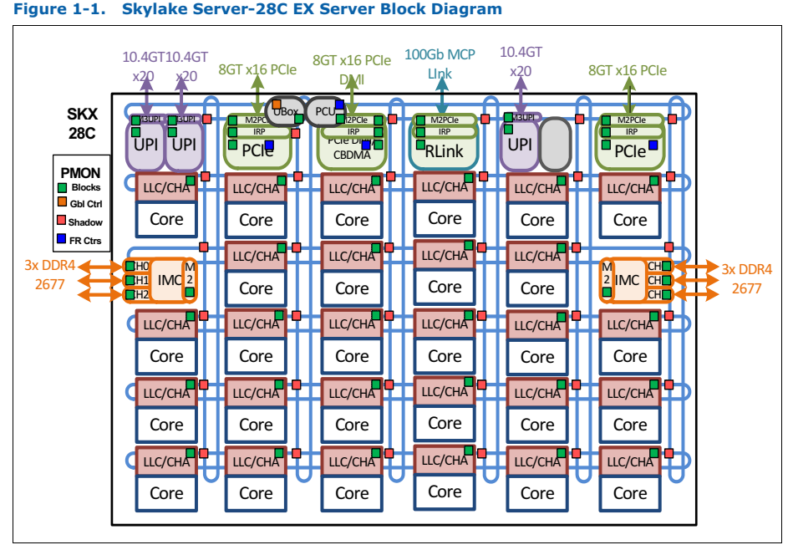
Chassis Performance Monitoring
Core PerfMon can tell SW how it is performing on an iA core - e.g. was the code scheduled to execute efficiently? Were the tasks well balanced?
Uncore monitoring can give SW a better sense where all that traffic was routed and what was involved in processing it.
https://software.intel.com/en-us/blogs/2014/07/11/documentation-for-uncore-performance-monitoring-units

Slide 10
DPDK packet processing using Direct Data I/O
CPU Socket
Core writes RXd preparing for receiving packet
NIC reads RXd to get buffer address
NIC writes packet
NIC writes RXd
Core reads RXd (polling)
Core reads packet and performs some action
CPU Cores
RAM
1
MEMORY CONTROLLER
6
5
LLC
RXd
Packet
2
4
3
1
NIC
Most of software thread work in CPU core and local cache
with minimal memory traffic per packet

Slide 11
Telemetry points
CPU Socket
CPU Cores
Core I/O data
processing
Integration with DPDK
RAM
Memory
bandwidth
1
MEMORY CONTROLLER
6
Core communicates
with NIC through
PCIe MMIO transactions
5
LLC
RXd
Packet
Intel DDIO makes LLC the primary target of
DMA operations
2
3
4
Writing back descriptors
may result in partial
PCIe transaction
1
NIC
Intel tools enable performance visibility of the platform at all layers:
hardware with all its key components and software acceleration engines

Slide 12
Understanding PCIe performance
Network Rx
(ItoM/RFO)
Inbound PCIe write
Network Tx
(PCIeRdCur)
MMIO Read
(PRd)
MMIO Write
(WiL)
Inbound PCIe read
Outbound CPU read
Outbound CPU write
Match workload I/O throughput
Look for MMIO
write traffic
Avoid DDIO miss
Avoid MMIO Rd
Optimize batch size
Avoid writing back
“partial” descriptors

Slide 13
Measuring memory bandwidth
CPU Socket
Reason with memory traffic:
Wrong NUMA allocation
DDIO Miss
CPU data structure
CPU Cores
RAM
1
MEMORY CONTROLLER
6
5
LLC
RXd
Packet
2
No memory traffic: Best
Fix it in the code!
Receive packets ASAP, descriptor ring sizes (needs tuning)
May be okay, but check for latency!
4
3
1
NIC

Slide 14
Measuring cross socket bandwidth
CPU Socket
CPU Socket
CPU Cores
CPU Cores
RAM
UPI CONTROLLER
UPI CONTROLLER
MEMORY CONTROLLER
LLC
LLC
RXd
Packet
RXd
Packet
1
NIC
1
NIC
Any QPI traffic will inevitably hurt performance.
If unavoidable, watch for link utilization

Slide 15
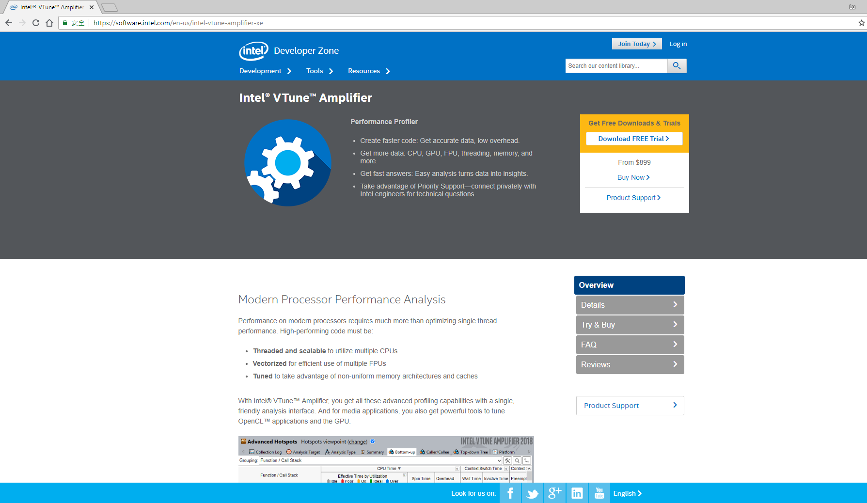
Intel® Vtune Amplifier

Slide 16
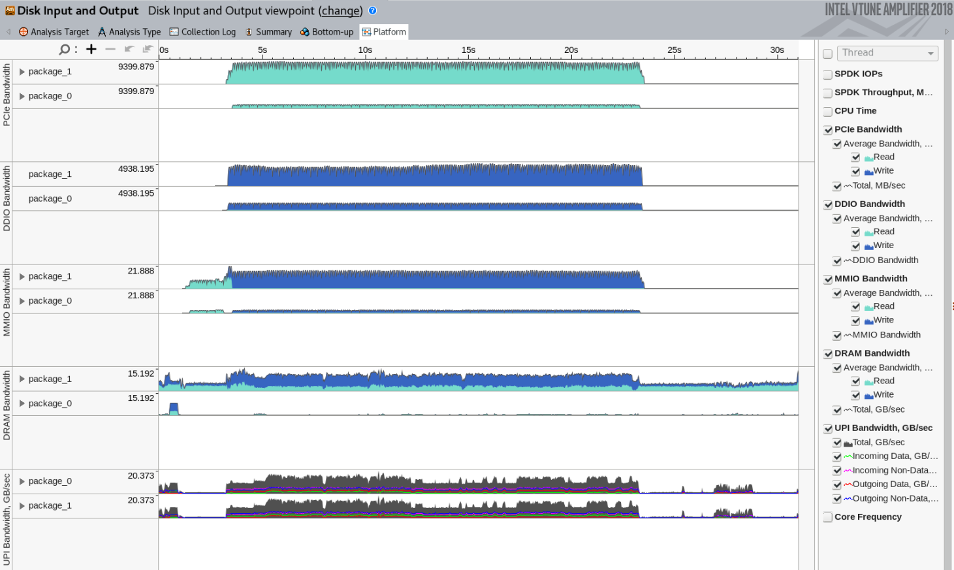
Intel® Vtune Amplifier
PCIe bandwidth with traffic breakdown per physical device
Intel DDIO misses resulted in write back to RAM
MMIO traffic. Avoid Reads and control Writes
DRAM bandwidth
Socket interconnect traffic
1
https://software.intel.com/en-us/intel-vtune-amplifier-xe

Slide 17
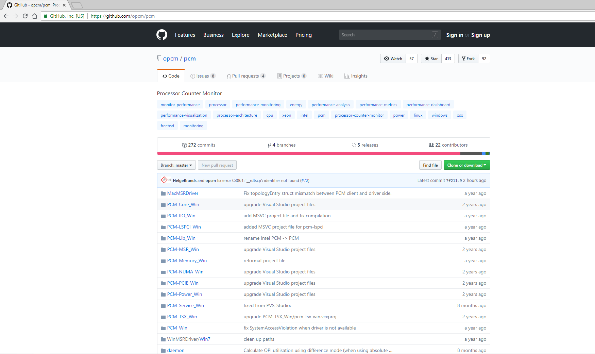
Performance Counter Monitor (PCM)
https://github.com/opcm/pcm

Slide 18
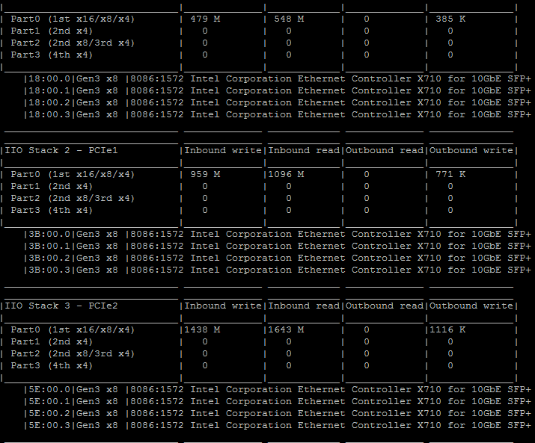
DPDK ip_pipeline Forwarding Example
Intel® Xeon® Platinum 8180
IIO Stack 0
Gen3x8
Intel® X710-DA4
10G
Intel® X710-DA4
10G
Intel® X710-DA4
10G
10G
10G
10G
10G
10G
10G
IIO Stack 1
Gen3x8
10G
10G
10G
IIO Stack 2
Gen3x8
Measure individual PCIe device bandwidth at x4 granularity
Enumerate downstream devices behind each IIO Stack
Monitor both inbound/outbound at DWord granularity
PCIe to system
CPU to PCIe
Can monitor VT-d IOTLB miss rate (opCode.txt)
Notes:
The output of the pcm-iio.x showed three different I/O bandwidth coming from 3 different PCIe NIC cards.
First 4x10G receive and transmit 10% of line rate @ 64 bytes.
Second 4x10G receive and transmit 20% of line rate @ 64 bytes.
Third 4x10G receive and transmit 30% of line rate @ 64 bytes.

Slide 19
Analyzing performance with Intel tools
Easy
Calibrate I/O bandwidth with expected performance
Check for unexpected cross-NUMA traffic
Check for unexpected PCIe MMIO traffic
Optimize workload to make use of Intel DDIO efficiently
1
Advance

Slide 20
Questions?
Patrick Lu
patrick.lu@intel.com
Roman Sudarikov
roman.sudarikov@intel.com

Slide 21
Backup

Slide 22
IIO transaction flow
Inbound Write Flows:
I2M – get line ownership for IIO, data is not required to be in the LLC
RFO – get line ownership and data in the LLC/eDRAM for IIO, deliver a copy of the data to IIO
WbMtoI – IIO delivers data to Cbo, releases ownership
CLFlush – IIO delivers data to Cbo, flushes to DRAM
Inbound Read and Snoop Flows:
RdCurrent – LLC delivers data to IIO
SnpInv – IIO releases ownership always
Peer to Peer Flows:
NcP2PB – Peer Write or Completion
NcP2PS – Peer to Peer Read
https://software.intel.com/en-us/blogs/2014/07/11/documentation-for-uncore-performance-monitoring-units

Slide 23
Configuring IIO transaction flow
Option 1: global per platform
Option 2: per root port
Option 3: per pci transaction

