Slide 1
Deflate your Data with DPDK
Lee Daly, fiona Trahe
Intel
September 2018

Slide 2
Agenda
Why add a compression capability to DPDK?
Key features and design decisions
Compressdev API
Compressdev PMDs
Next steps

Slide 3
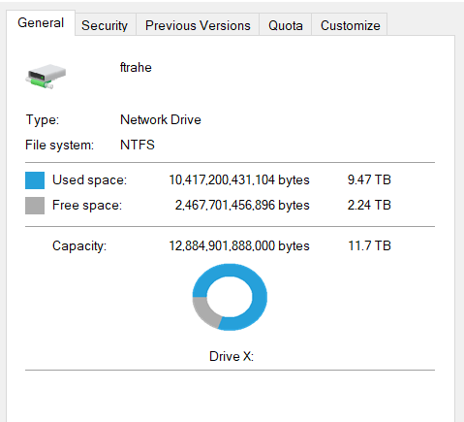
Compression use cases
Networking
&
Storage
Notes:
Networking and storage.
Network segment – reduce the size of packets to reduce load in the network.
Influenced requirements around stateful flows as all data in a data set may not be available to compress at the same time.
Storage segment – reduce the space needed by file systems or object storage databases E.g. SPDK. Less need for stateful as all the data typically available at the same time.
Applications sometimes already building in SPDK or DPDK for passing data between nodes.
Both segments looking for a generic API for compression. Currently need to code separately for zlib or proprietary hardware and software compression engines.

Slide 4
Collaborative development
Notes:
API proposed by Intel, led by Fiona Trahe and Pablo de lara Guarch
Developed in collaboration with Cavium led by Shally Verma and also with input from NXP.
Used github for collaboration in addition to mailing list.

Slide 5
Agenda
Why add a compression capability to DPDK?
Key Features and Design Decisions
compressdev API
compressdev PMDs
next steps

Slide 6
Key Design Decisions
Standalone CompressDev API
Alternatives explored and discarded include;
Extend cryptodev.
Move cryptodev and compressdev to a common acceldev.
Build on rawdev.
Include in SPDK
Separate stateless and stateful operations
Use 2 session-like structures
rte_comp_private_xform
rte_comp_stream
Use mbufs to pass data to/from PMDs
Use a different method
(More on this later)

Slide 7
Key Features
Asynchronous burst API
To support HW & SW acceleration.
Chained Mbufs
To allow compression for data greater than 64K.
Compression Algorithms
#1 Deflate
#2 LZS
Compression Levels
-1: PMD Default
1: Fastest
.
.
.
9: Best Ratio
Checksum
#1 CRC32
#2 Adler32
#3 Combined - Adler32_CRC32
Hash Generation
#1 SHA1
#2 SHA256

Slide 8
Agenda
Why add a compression capability to DPDK?
key features and design decisions
Compressdev API
compressdev PMDs
next steps

Slide 9
Compressdev Components
Compression Application
DPDK
DPDK Compression Framework Components
Device Mgmnt
Stats & Capabilities
Stream Mgmnt
Operation Mgmnt
Burst
Compressdev
Drivers
ISA-L
ZLIB
QAT
Octeontx
libisal.a
libzlib.a
Hardware
Accelerators
QAT H/W
Octeontx

Slide 10
Compression API Flow
Application Start
Allocate src/dst memory
Op Pool Creation
Device Config
Queue Pair
setup
Device Start
Create Private Xform
Main Loop
Op allocate
Build the Ops
Enqueue
Burst
Dequeue Burst
Free ops
Free Private Xform
Application End
Stop Device
Close Device

Slide 11
Agenda
Why add a compression capability to DPDK?
key features and design decisions
compressdev API
CompressDev PMDs
next steps

Slide 12
CompressDev poll mode drivers
Software Drivers
Hardware Drivers
Intel ISA-L PMD
Intel QAT
PMD
Cavium
Octeontx PMD
Zlib PMD
Employs the compression engine from Intel’s ISA-L library, optimized for Intel Architecture.
Utilizes Intel’s QuickAssist family of hardware accelerators.
Software driver uses Zlib’s compression library.
Uses HW offload device, found in Cavium’s Octeontx SoC family.

Slide 13
Agenda
Why add a compression capability to DPDK?
key features and design decisions
compressdev API
compressdev PMDs
Next Steps

Slide 14
Next Steps
Performance Tool
Which will measure
Throughput
Compression Ratio
API Changes
An alternative to using the mbuf.
PMDs should append dst buffer.
Remove Experimental Tag
Future developments
Sample App?
Stateful in PMD?

Slide 15
Questions?
Lee Daly – lee.daly@intel.com
Fiona Trahe – fiona.trahe@intel.com

