Slide 1
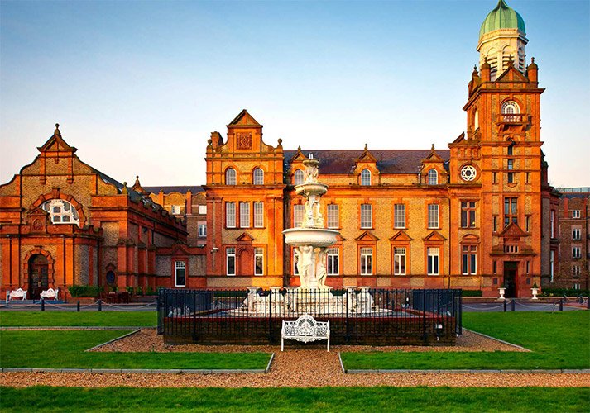
Introductory Remarks from the DPDK Project Governing Board
Jim St. Leger, Governing Board Chair
DPDK Summit Userspace – Dublin – 2018

Slide 2
Irish News: All-Ireland Hurling Championship
Congratulations Limerick

Slide 3
More Importantly…

Slide 4
Event Sponsors – Thank You !
And all the event organizers who make this volunteer community summit possible

Slide 5
DPDK Project Governing Board
Chair Vice-Chair Tech Board Rep
Jim St. Leger Bob Monkman Jerin Jacob
Board Members
Liza Fung Maen Suleiman Per-Erik Möckelind James Hendergart Erez Scop
Jaswinder Singh Rashid Khan Songmin Yan
Silver Board Rep George Zhao
Project Manager
Trishan de Lanerolle

Slide 6
DPDK Project Growth – Membership

Slide 7
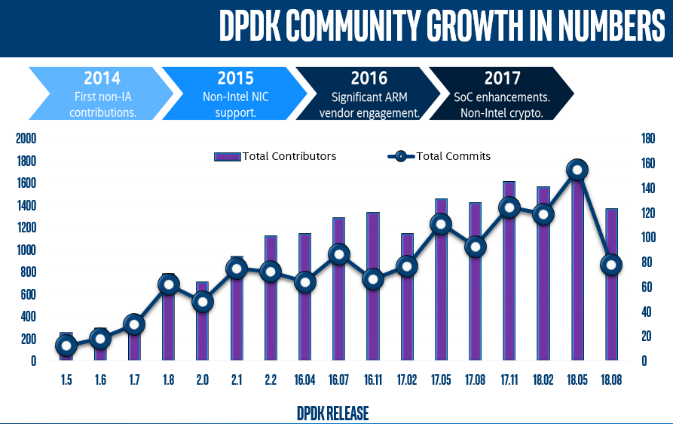

Slide 8
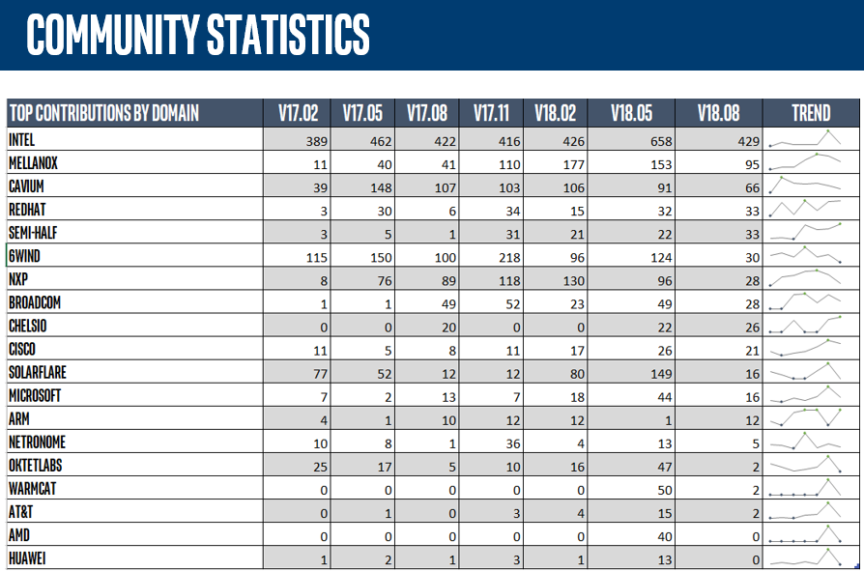

Slide 9
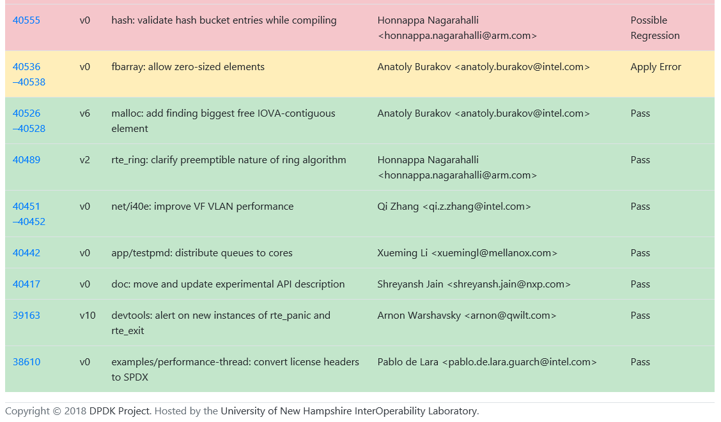
DPDK Open Lab Update
What it’s for:
Automated performance regression CI testing of new patches.
When a new patch is received, automatically test and determine if it degrades performance on one or more architectures.
Provides input to Maintainers on whether to accept patches or request re-work.
Scope may expand in future: test DPDK-enabled SW apps, use of lab for demos etc.
Draft results dashboard is now available at: https://dpdkdashboard.iol.unh.edu/results/dashboard/

Slide 10
What’s New? Our Website!

Slide 11
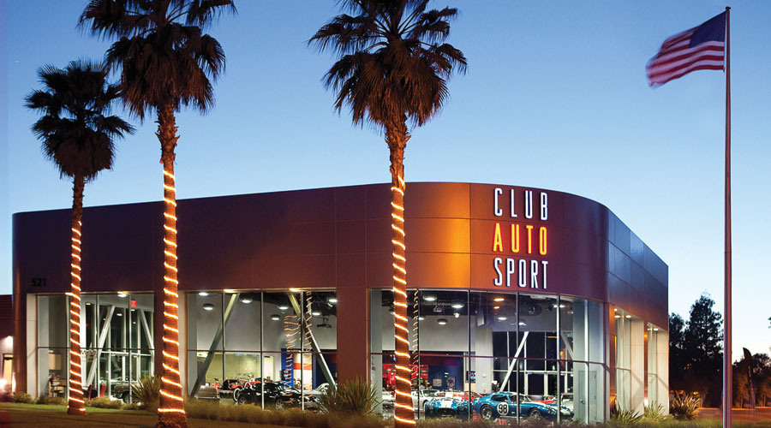
Upcoming Events – DPDK Summit USA
Club Autosport
San Jose, California
December 3-4, 2018
https://www.dpdk.org/event/dpdk-summit-north-america-2018/
CFP Open Now!!!
Closes October 22
Submit your talk!
Registration is open

Slide 12
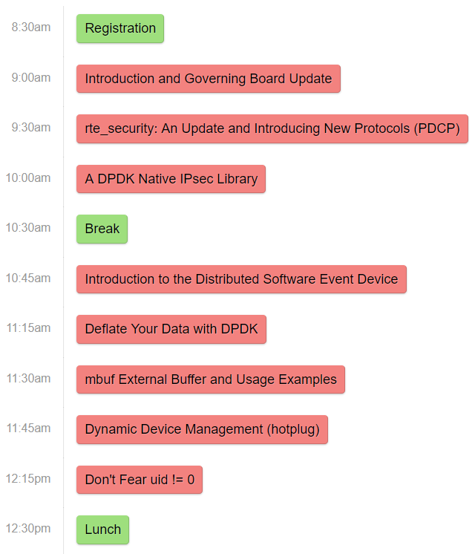
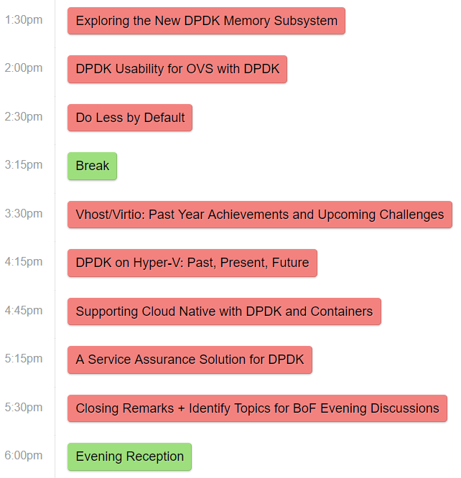
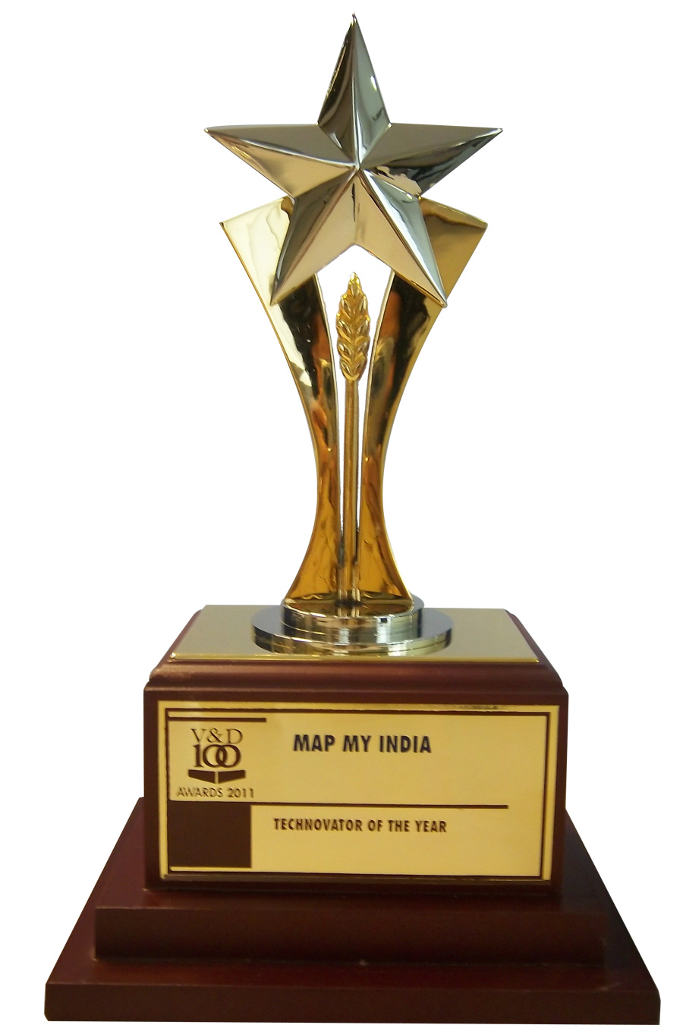
Agenda - Wednesday
dpdkuserspace2018.sched.com/
Longer Talks
Lightning Talks
AWARDS
Downstairs
Downstairs

Slide 13
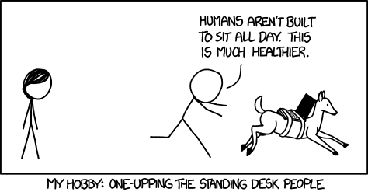
Userspace Goals
Share information
Exchange ideas
Challenge each other
Discuss, debate, resolve, repeat…
Meet other developers face-to-face IRL
Have some fun!

Slide 14
Thank you

