Slide 1
vDPA for Vhost Acceleration
Xiao Wang, Intel

Slide 2
Agenda
Vhost Evolution
An Ideal Vhost HW ACC Model
vDPA Design and Impl
  DPDK Vhost Lib and vDPA Driver
  QEMU Vhost User Extention
  Upstreaming Status
Acc Vhost with vDPA
Key Takeaways

Slide 3
Vhost Evolution
Vhost in pure SW
Para-V Flexibility ☺
An ideal framework would achieve:
Virtio spec compliant
Pass-thru like perf
Cloud friendly
Multi-vendor
VM
VM
VM
Virtio drv
Virtio drv
Virtio drv
Virtio dev
Virtio dev
Virtio dev
QEMU virtio backend
Kernel vhost
DPDK vhost
Tap
Tap
VM
VM0
VM1
HW accelerator comes
Pass-thru for virtio?
virtio 0.95&1.0 ☹
Multi-vendor ☹
LM with Pass-thru ☹
Stock VM ☹
Virtio drv
Virtio 0.95
Virtio 1.0
VM0
VM1
Virtio drv
Virtio drv
GOAL
SW vhost
Live Migration
NIC w/ Switch
NIC w/ Switch

Slide 4
vDPA: enable data path pass-thru within Para-V
vDPA: vhost Data Path Acceleration
  Build pass-thru like data path within Para-V
  Inherit all PV advantages
Decomposed Data Path on ACC
  DMA Enq/Deq VRING via IOMMU
  Interrupt Notification
    VFIO INTR eventfd associate with IRQFD
    IRQFD as token for irq_bypass Prod/Cons
    Leverage existing posted-interrupt support
  Doorbell Kick
    Add guest physical memory slot for doorbell direct mapping (virito 1.0, MMIO)
    SW Relay IOEVENTFD to trigger doorbell (virtio 0.95, PIO)
ACC = Accelerator (VRING Capable)

Slide 5



vDPA Design & Impl
QEMU
Leverage vhost user
  Unified interface for SW/HW
  SW data path fallback
DPDK vhost lib
  vDPA resource management
  API for vDPA register/unregister
  API for device attach/detach to socket
  vdpa_ops: vhost message driven callback
socket
…
…
{dev_addr,vdpa_ops}
register
vhost
vdpa drv
init
VFIO
vdpa dev
Feature
IOMMU
Ring

Slide 6





Partial Pass-thru for Direct Kick
VM
Virtio Dev
Extend vhost protocol:
VHOST_USER_PROTOCOL_F_HOST_NOTIFIER
Per-queue notify info
Partial Pass-thru: Notify Reg => HW doorbell
No VMEXIT ☺ (virtio1.0)
Notify Reg
Notify Reg
QEMU
Slave Handler
Master Channel
Slave Channel
Extended Page Table
vhost user
vDPA driver
vDPA device
Doorbell
Doorbell

Slide 7
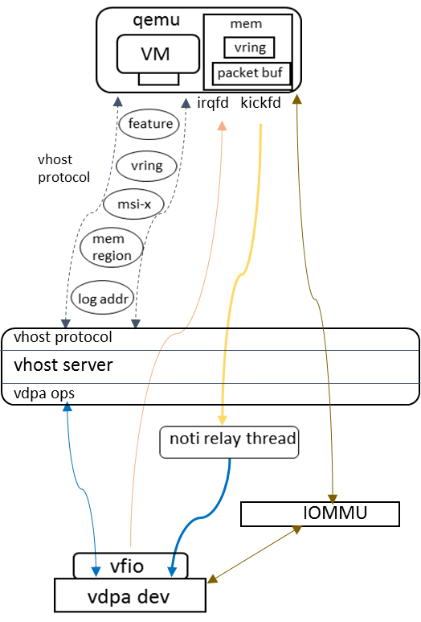
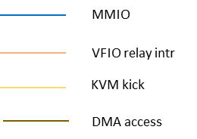
Relay for Virtio 0.95
0.95 kick with PIO
Version aware by negotiated feature
Relay based on ioeventfd
Notify_suppress to reduce VMEXIT

Slide 8
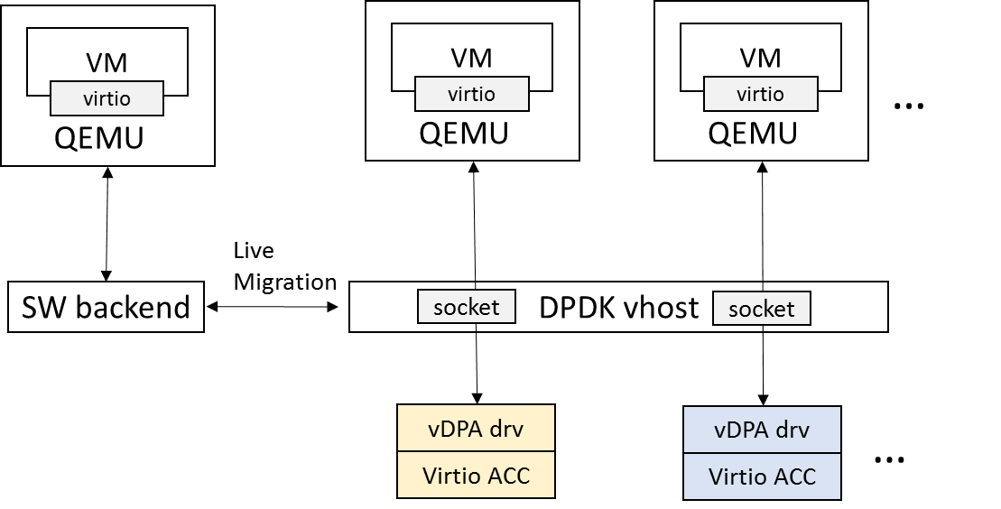
Acc Vhost with vDPA
HW focus only on data path
On-demand resource assignment
  Offload features
  MQ
Live migrate stock VM to vDPA
  No feature gap
  Cross-backend LM
  Vice Versa

Slide 9
Upstreaming Status
18’Q2 QEMU vhost user support for vDPA [Merged]
DPDK 18.05 vDPA framework in vhost [Merged]
DPDK 18.05 IFCVF vDPA driver [Merged]
2018 Q3/Q4 support vIOMMU and Posted Interrupt [WIP]
Kernel vDPA (https://lwn.net/Articles/750770/) [RFC]
Para-virtualized device w/ HW acceleration is getting mature.
Welcome on board!

Slide 10
Credits (in alphabetical order)
Authors:
Cunming Liang
Tiwei Bie
Xiao Wang
Zhihong Wang
Acknowledgements:
Amnon Ilan
Dan Daly
Ferruh Yigit
Jason Wang
Martin Roberts
Maxime Coquelin
Michael S. Tsirkin

Slide 11
Key Takeaways
vDPA enables vHost HW acceleration in a cloud friendly way
Framework ready for production
Allow multi-vendor HW design

Slide 12
Thanks!

