Slide 1
DPDK Accelerated Load Balancer
DPVS: open source HIGH PERFORMANCE l4 Load balancer BASED ON DPDK.
Lei CHEN @ IQIYI.com, 2018.

Slide 2
Agenda
Load Balancer Challenges
Performance Bottleneck
How to Achieve High Performance
Architecture and Modules for DPVS
Implementation Details and Examples
New Features & Future Plan

Slide 3
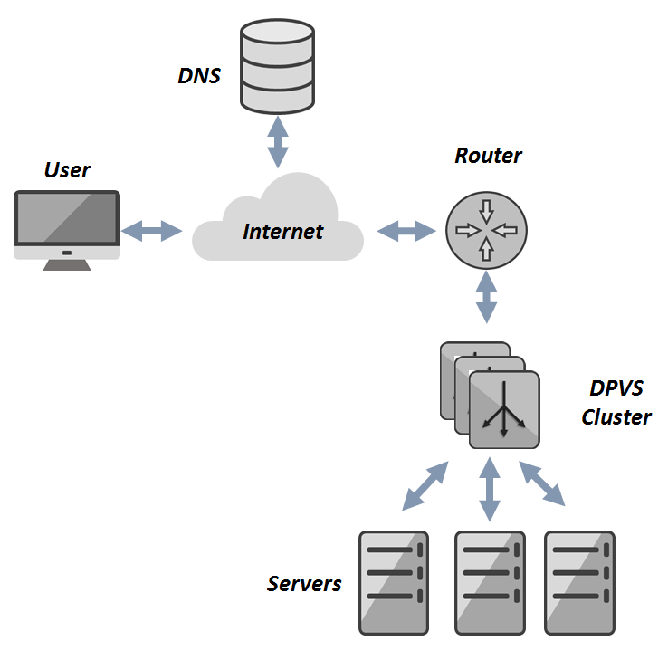
Load Balancer Challenges
High Performance
Concurrency, Throughput, …
Cost (less machines)
Various Use Cases
Load Balancing (FNAT, DR, TUN)
IDC Internet access (SNAT, GRE)
Security Related
Easy to Evolution
Development & Customization.
Maintain & Bug Fixing & Deployment.

Slide 4
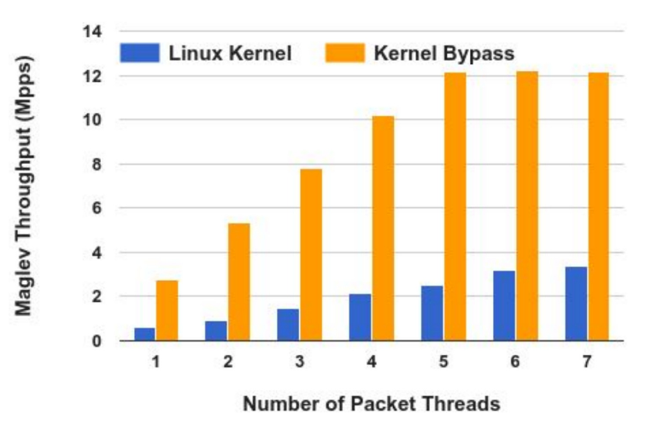
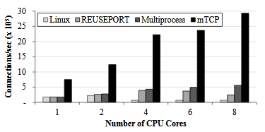
Why Kernel Based LB Not That Fast ?
Kernel is the bottleneck ? (LVS/2.6.32)
Context Switching
Resource Sharing & Locking
IRQ Storm
Complicated Features (Deep call-stack)
Kernel by-pass Tech
Good aspect
Performance, Easy Develop, Adoption, ..
Bad aspect
Expensive, No Multi-purpose, No Utilities,
Stable and security.
Pic from google maglev.
Pic from mTCP.

Slide 5
How to Achieve High Performance ?
Kernel by-pass Tech
L2/L3 Forwarding
Load Balancer
HFT Case
“Share-nothing”
CPU localization
No share == no lock
Avoid Context Switch
Queue/CPU/Task bonding
Disable scheduling
Polling vs. Interrupting
Zero Copy
Pre-allocated Cache
NUMA Awareness
Prefetch, Huge-page
… …

Slide 6
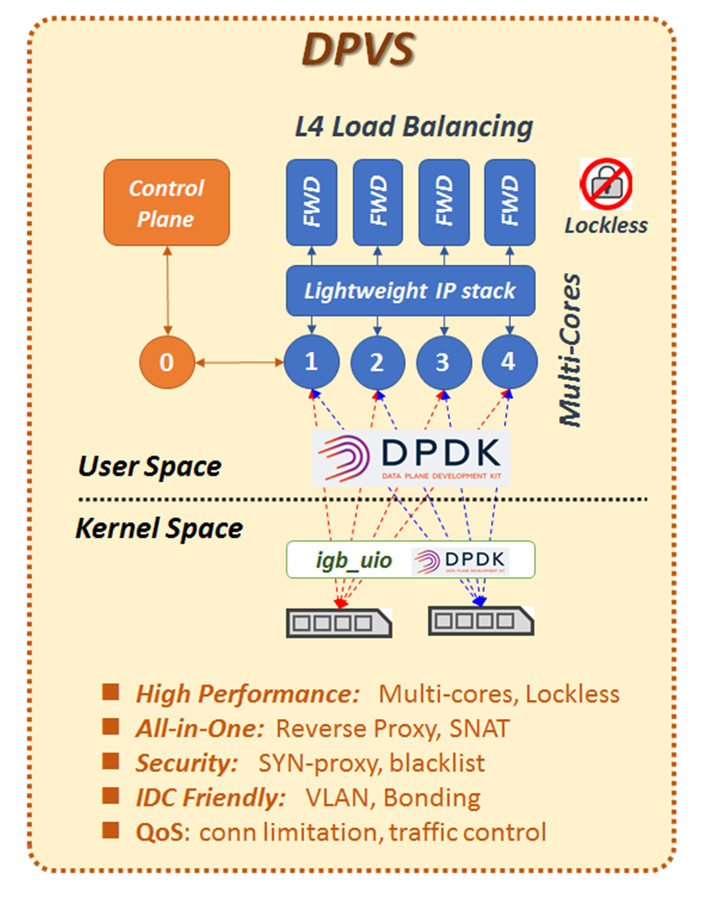
DPVS: high performance LB based on DPDK
Master/Worker Model
NIC Queue/CPU Bonding
User-land Lite IP-Stack
Lockless for Key Data
Lockless Inter-core Msg
All-in-One Functional

Slide 7
DPVS: Function Modules

Slide 8
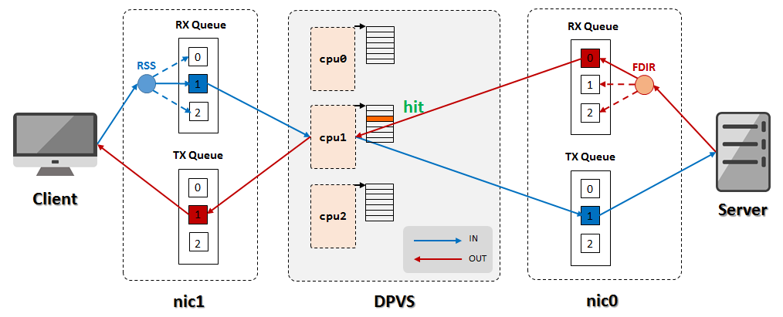
NIC Queues & CPU Bonding

Slide 9
IDC Friendly: Virtual Devices

Slide 10
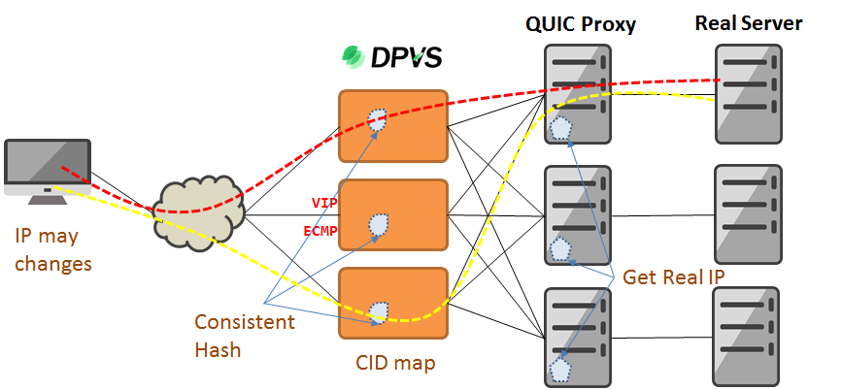
QUIC Support: UOA and ConHash
Connection IP/port changing
Use CID for Schedule
Some App need Client IP
UOA
IP Option
Private Protocol

Slide 11
Something new & future
Available Recently
Consistent Hash
UOA: get real UDP client IP
QUIC: support CIP based schedule
Tunnels: IP-in-IP, GRE
Traffic Control (Linux Like, Lite Ver.)
Plan
Big NIC (25G/40G) & higher performance
IPv6 Support
Session Sharing
SNAT: Traffic Isolation
Session Logging

Slide 12
Thanks !
https://github.com/iqiyi/dpvs

