Slide 1
link level network slicing with DPDK
Jiezheng@vmware.com

Slide 2
Agenda
Background and Perspectives
Framework Overview
Reference VNF: L2 vSwitch
Experimental data and Conclusion

Slide 3
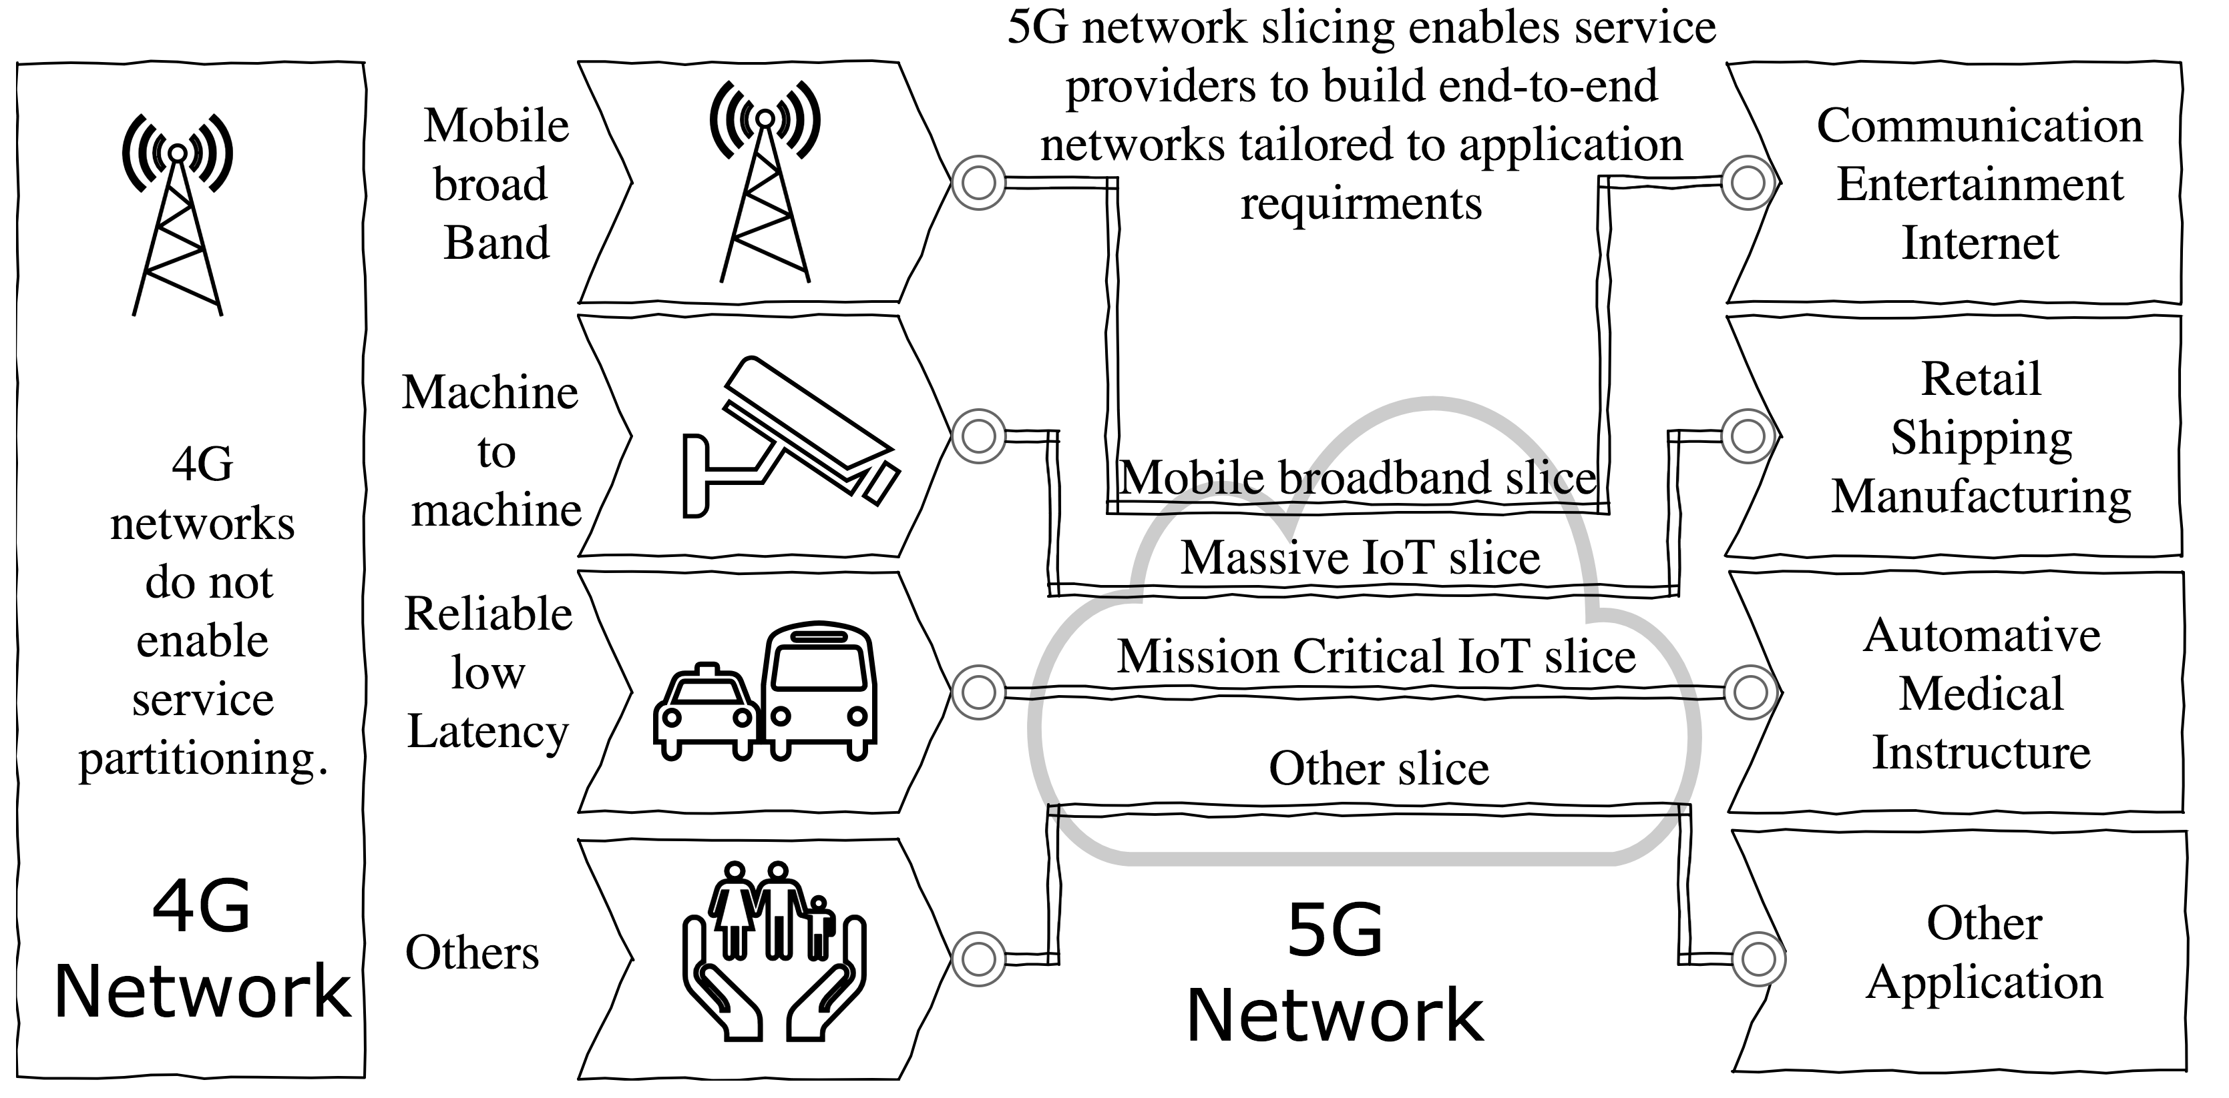
Background
What is Network Slicing?
Notes:
DPDK is absolutely the Keystone of NFV!

Slide 4
Background
network slicing leverages NFV and(or) SDN!
service criticality:
highly performed (low latency and high bandwidth)
highly available(service continuity)
… …
what we do to build the virtual (still as infrastructure) network?
Notes:
May be deleted utimately

Slide 5
Perspectives
virtual networks run atop COTS switches and servers.
philosophy: the nearer the VNF approaches the infrastructure network, the less overhead probably will be.
no virtual switch in hypervisor domain.
VNFc(trusted environment) take responsibility of physical resource partitioning.
how we make it ?
in SDDC, topology is known and controlled.
calculate virtual network topology(quantify the network)
refine virtual network topology
enforce traffic forwarding with deterministic path.

Slide 6
Agenda
Background and Perspectives
Framework Overview
Reference VNF: L2 vSwitch
Experimental data and Conclusion

Slide 7
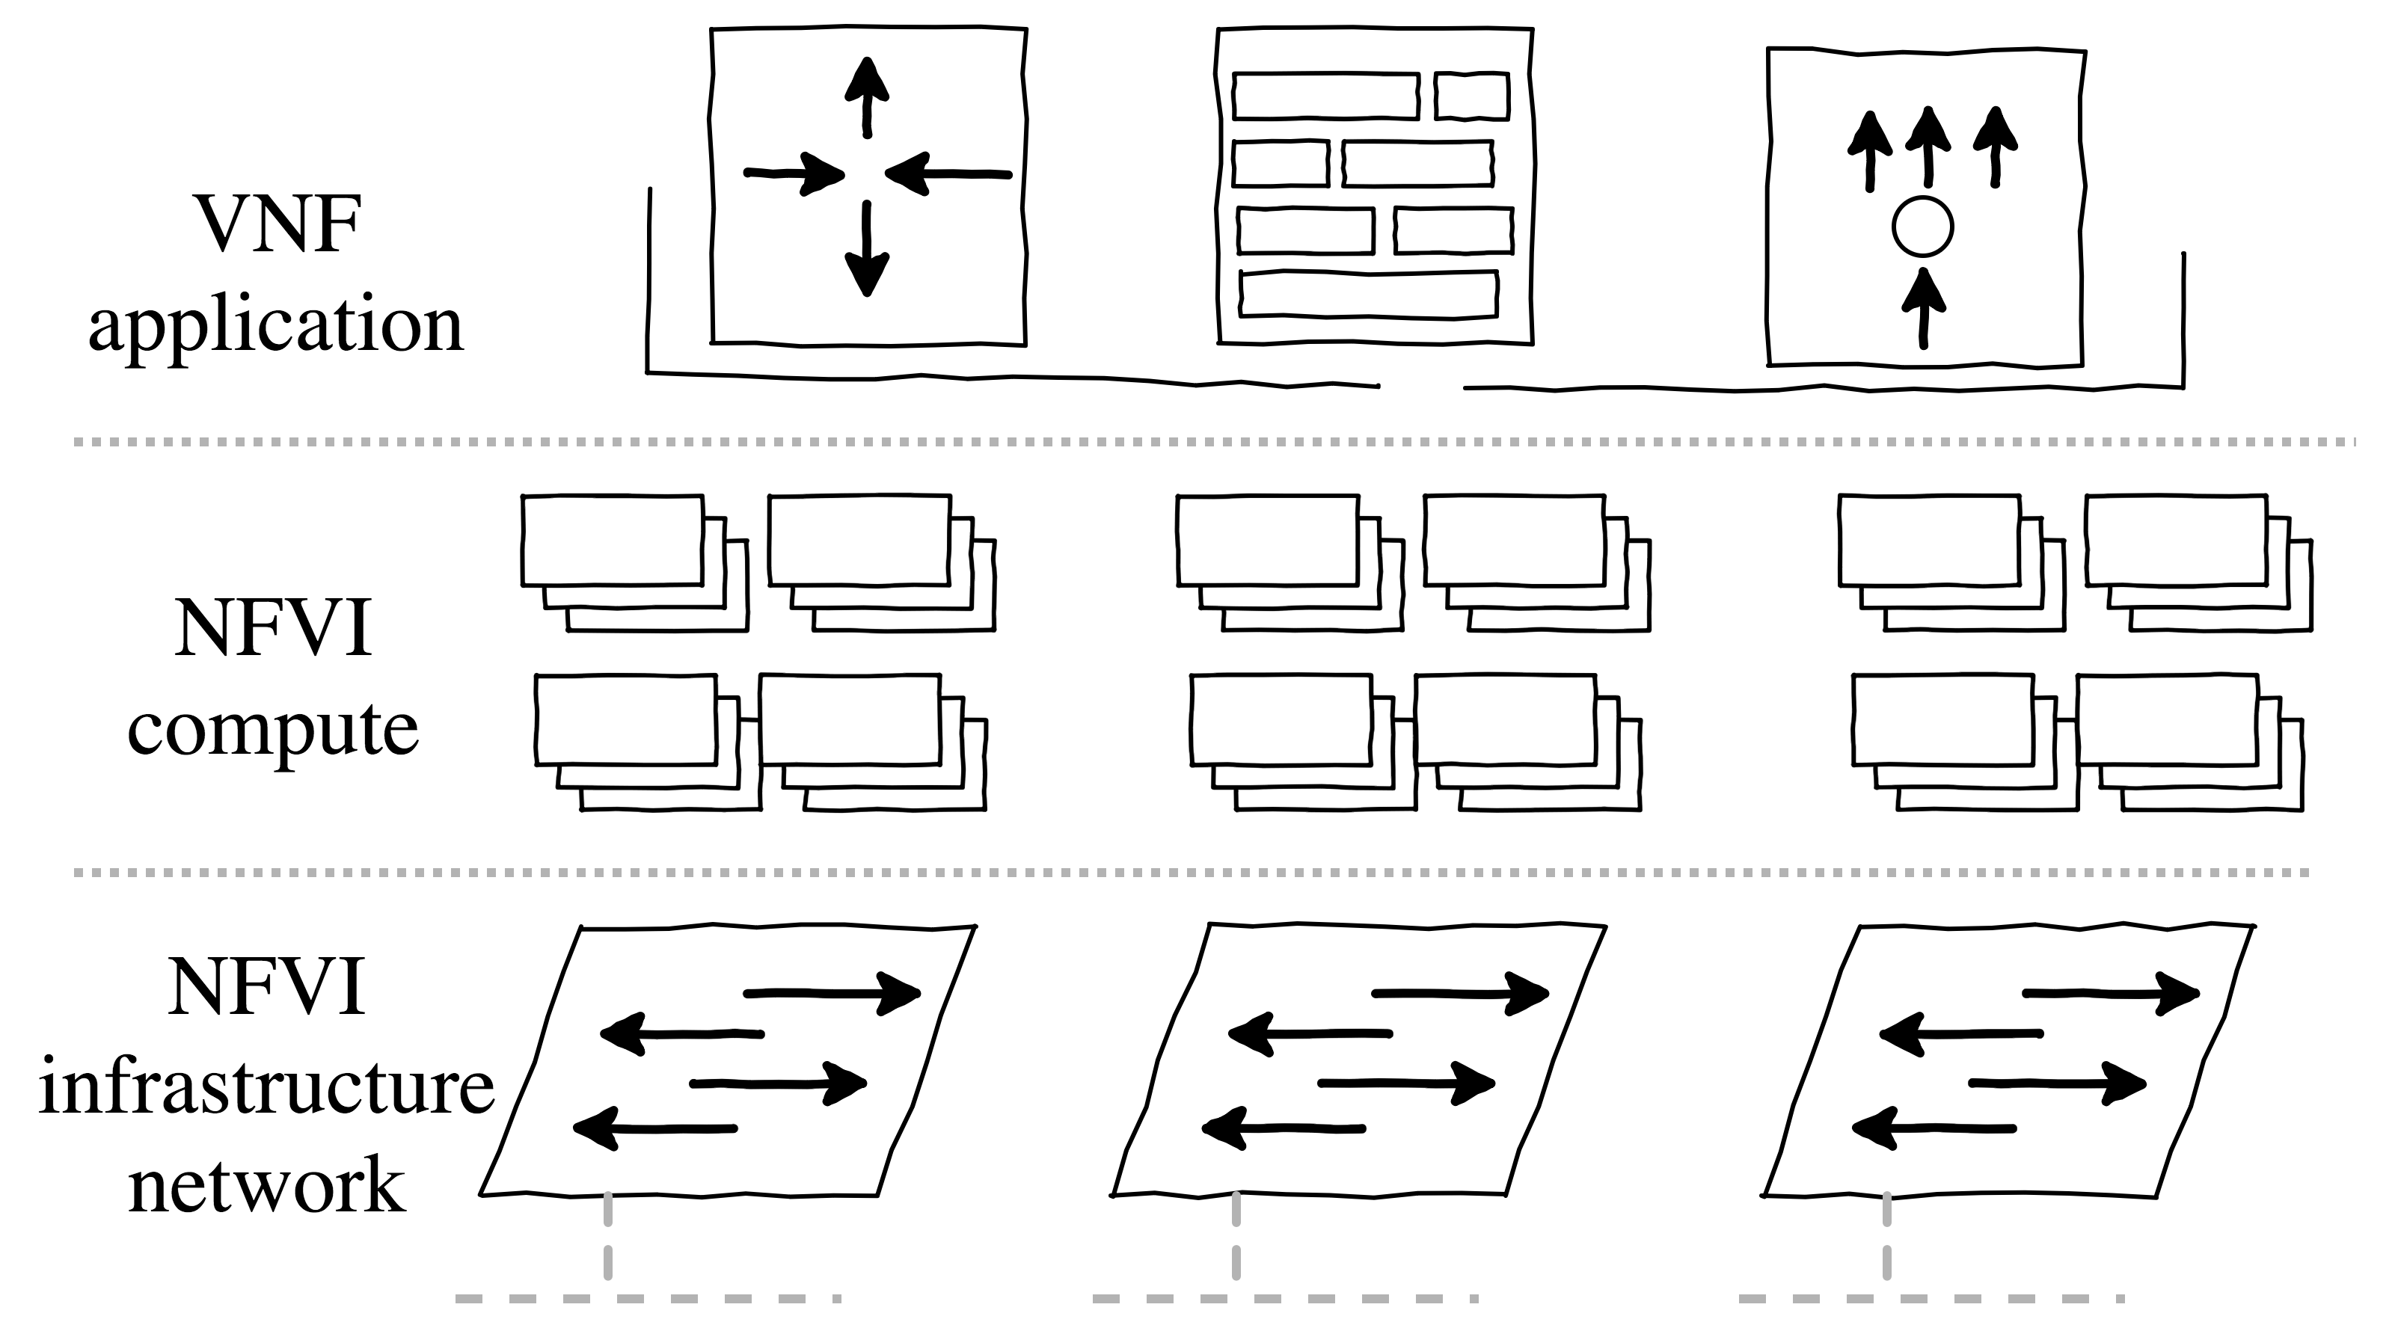
Framework Overview
resource inventory
infrastructure network can be multi-segmented
every segment is a lan zone
every segment can employ its own L2 technology
STP
SPB
TRILL

Slide 8
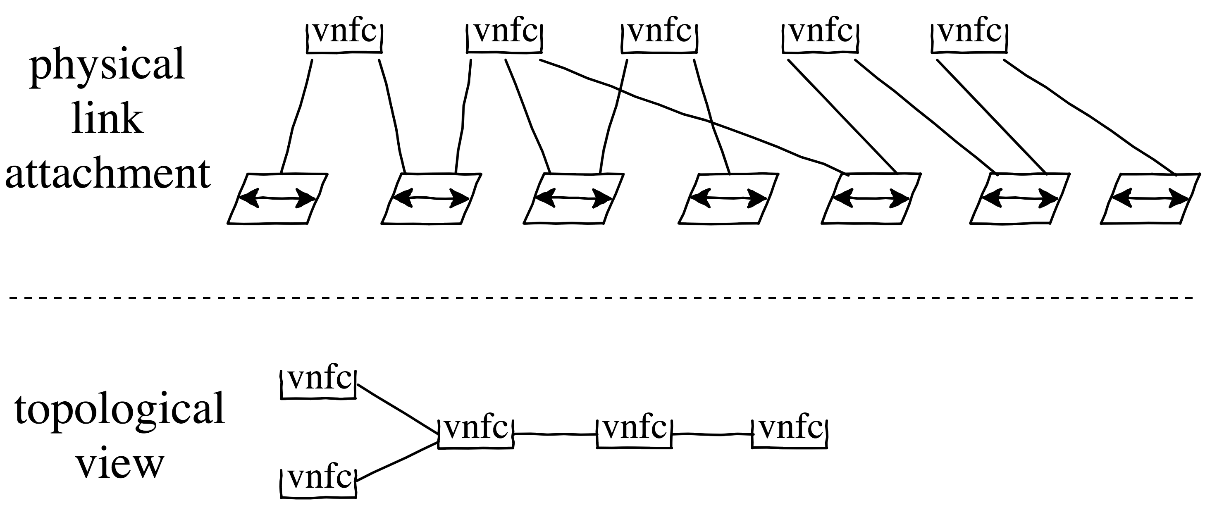
Framework Overview
logical topology structure
vnf container attaches physical links to infrastructure network(more likely SR-IOV VF).
neighborship: any two physical links which are attached to the same lan segment are paired as neighbors.

Slide 9
Framework Overview
virtual network service to ease service chaining.
pseudo wire service: ethernet-line(E-LINE)
point to point shorted path (Dijkstra’s Algorithm)
(direct/label) forwarding
pseudo lan service: ethernet-lan(E-LAN)
minumum spanning tree(Prim’s Algorithm)
(mac based/label) forwarding
BUM traffic forwarded to the tree(not full meshing replication)
what is in common?
uniform weighting metrics
multiple services in work(ECMP)

Slide 10
Agenda
Background and Perspectives
Framework Overview
Reference VNF: L2 vSwitch
Experimental data and Conclusion

Slide 11
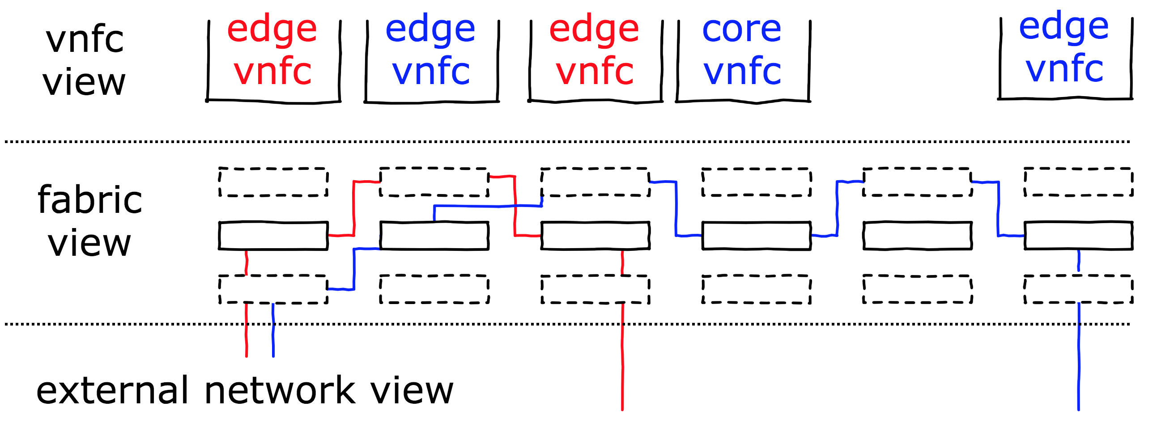
Reference VNF: vSwitch
description:
an end-to-end network slice that features bridging among any LAN segments.
VNF components:
edge vSwitch vnfc: external network access
core vSwitch vnfc: concatenate any two adjacent VNFCs.
Notes:
service identification:
Ethernet over MPLS, RFC448
mac-in-mac encapsulation
ingress label identifies service instance
egress label

Slide 12
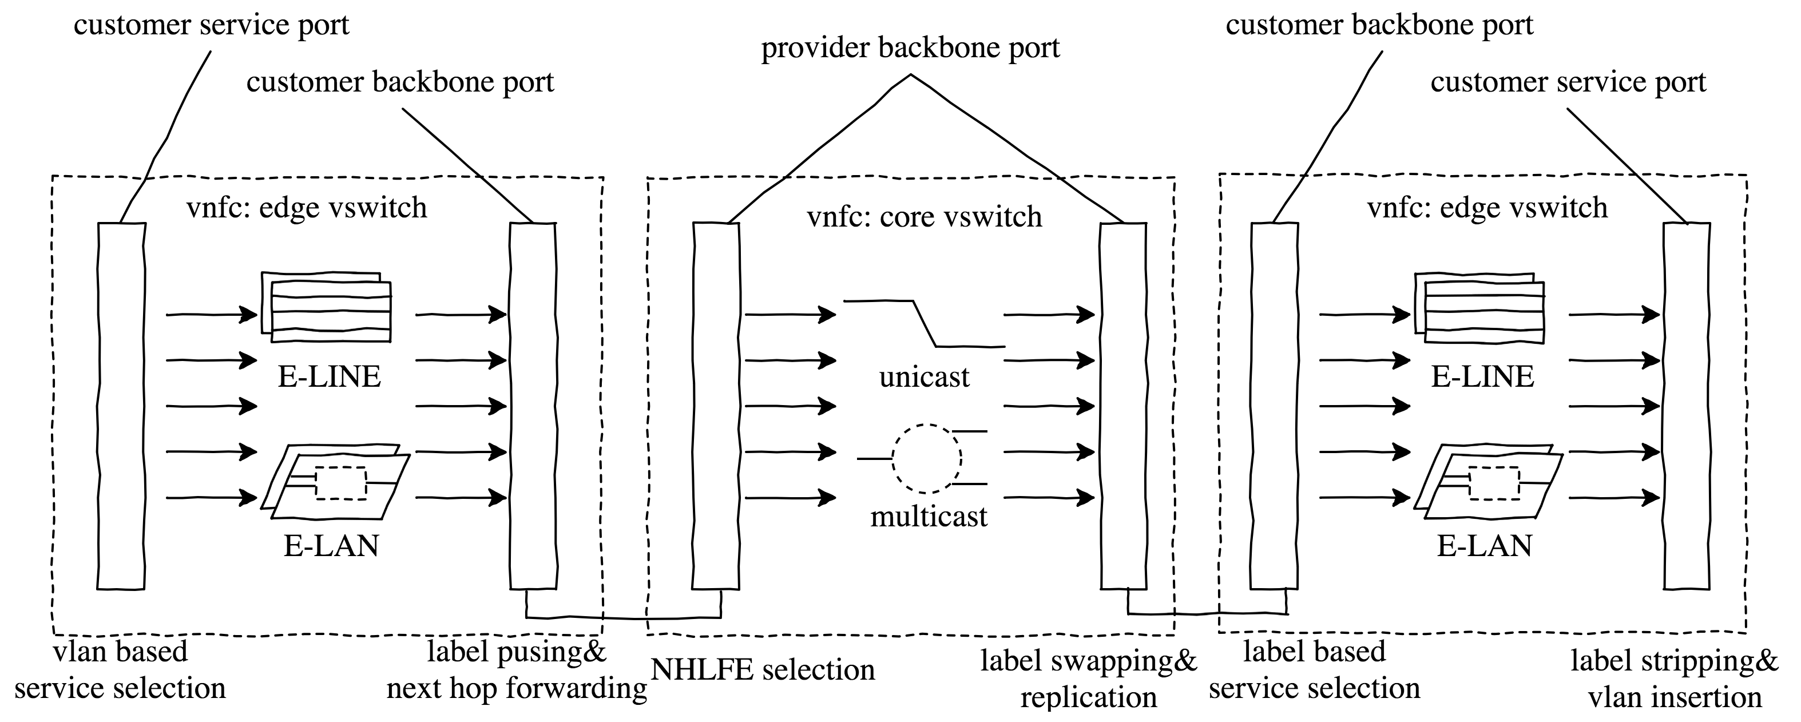
Reference VNF: vSwitch
datapath flow

Slide 13
Reference VNF: vSwitch
vSwitching processing complexity
Items | Spatial complexity | Temporal complexity
csp-input | 2^12 vlan entries per csp interface | o(1) to find vlan distribution entry
e-line-forward | 1 <vlan,interface> entry and 1 <label,nhlfe> entry | all o(1) to find the fwd entries
e-lan-forward | 64 <vlan,interface> and 64 <label,nhlfe> and 2^16 fib base entry per e-lan and [n/48,n] fib entry | O(m/48) to find the mac fwd entry, where m is the average hash bucket’s list length
cbp-input | 2^20 label entries per cbp interface | O(1) to find label distribution entry
pbp-input | 2^20 label entries per pbp interface | o(1) to find unicast fwd nhlfe o(n) to enumerate multicast entries where n by default set to 64

Slide 14
Agenda
Background and Perspectives
Framework Overview
Reference VNF: L2 vSwitch
Experimental data and Conclusion

Slide 15
Performace at scale
For edge vSwitch vnfc:
~14Mpps per core for E-LINE service traffic pattern.
~12Mpps per core for E-LAN unicast traffic pattern.
~12Mpps per core for E-LAN BUM traffic pattern.
For core vSwitch vnfc:
~14Mpps per core for unicast traffic pattern.
>8Mpps per core for multicast traffic pattern with at most 8 branches.
Latency:
average latency ~20 usec for E-LINE/E-LAN unicast traffic
average latency ~25 usec for E-LAN multicast traffic.
compute: Intel(R) Xeon(R) CPU E5-2630 v3 @ 2.40GHz with 20M L3 cache
network: Intel Xl710 dual ports. 4 virtual functions for each port.

Slide 16
Conclusion
Overall latency evaluation(on an end-to-end basis)
$Loverall=Dtopology × Lvnfc+\left( Dtopology+1 \right) × Linfra$
orchestration policy:
network resource oriented.
span least LAN segments.
Resource overuse(on a per-link basis).
on the premise of network resource (virtual function) quantification.
preserve links for critical service to avoid oversubscription.
current policy: static allocation.
Envisaged VNF Availability:
Multiple service copies(active-standby/ECMP) with service monitoring?
per-hop availability?

Slide 17
Thank You

